Slide 1
The Olmec Civilization

Slide 2
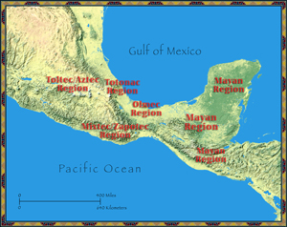
Mesoamerica
Meso = means middle
Refers to any cultures that lived in present-day Mexico & Central America

Slide 3
Olmec Civilization
One of the earliest Mesoamerican civilizations
Located near Gulf of Mexico
Knowledge of them comes from excavations of 2 main sites = San Lorenzo and La Venta → both discovered in the 1930s

Slide 4
Olmec Civilization
Olmec = known for gigantic stone heads carved from basalt (volcanic rock)
Some more than 9 feet tall
Some weighed as much as 40 tons
Heads of rulers
Built without wheels or “beasts of burden” → Olmec moved these heads about 60 miles from the mountains to the sites where they were found
Think about the giant head from Legends of the Hidden Temple! His name was Olmec!

Slide 5
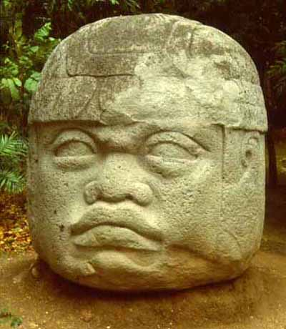
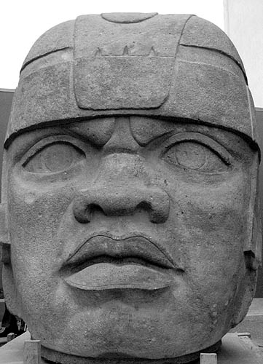
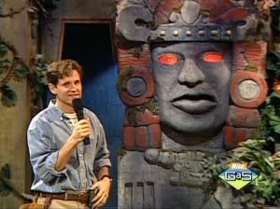

Slide 6
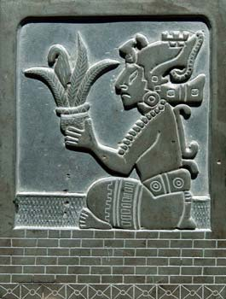
Olmec Civilization
Religion played an important role in the lives of the Olmec
Many carvings found of the main Olmec god = a being with a human body and the catlike face of a jaguar
Olmec believed the jaguar god controlled the harvests

Slide 7
Olmec Civilization
Early Olmec farmers used slash-and-burn farming = farmers cut down trees to clear land & burned whatever was left
Planted maize and other crops among fertile ashes
Problem = soil became exhausted after about 2 years
Farmers then shifted fields & repeated the cycle

Slide 8
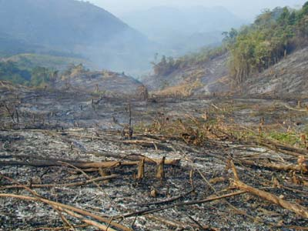

Slide 9
Olmec
Olmec often traded with other Mesoamerican civilizations
Olmec artifacts found in other regions
Olmec ideas show up with later civilizations, such as:
Religious ceremonies
Sacrificial rituals
Bloodletting
Game of pok-a-tok

Slide 10
Olmec Civilization as the “Mother Civilization” in Mesoamerica
Because of the influence that the Olmec civilization had on future civilizations within Mesoamerica, it is often referred to as the “Mother Civilization” in Mesoamerica

Slide 11
Pok-a-tok
A ritual ball game = rubber balls were batted back and forth across a walled court
Symbolized the back & forth struggle between this world and the next

Slide 12
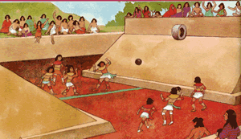
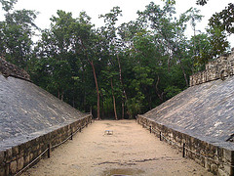

Slide 13
Religious Rituals of the Olmec
Bloodletting
Sacrifice of humans, animals, and valuable objects

Slide 14
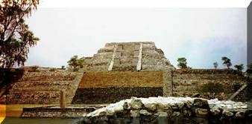
Olmec Religion
Olmec rulers = BOTH political leaders AND spiritual leaders
Performed rituals and ceremonies to satisfy the gods
Temples and pyramids built where thousands could gather for special religious ceremonies and festivals

Slide 15
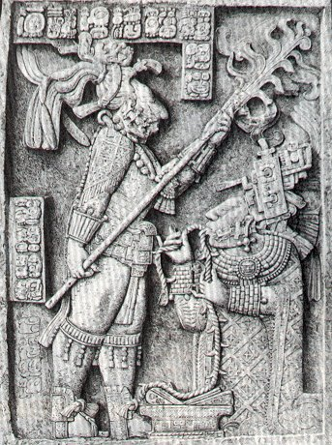
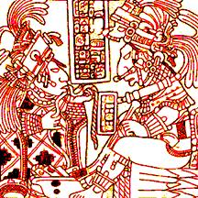
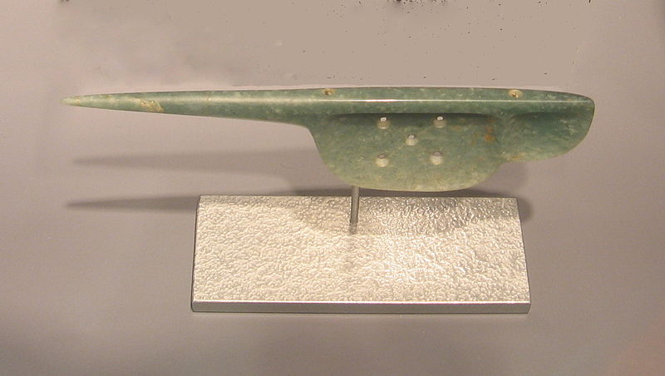
Bloodletting
Tools used:
Blades
Stingray spines
Sharks’ teeth
Obsidian flakes
Rope with thorns
Jade “spears”

Slide 16
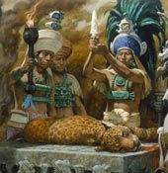
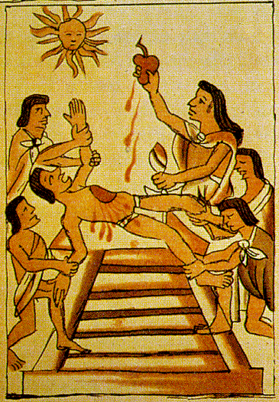
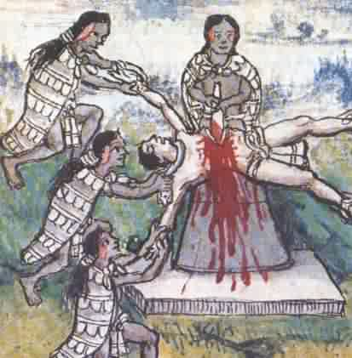
Sacrifice

Slide 17
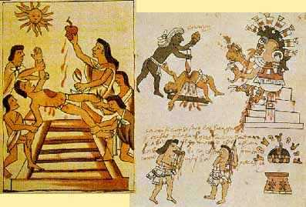

Slide 18
