Slide 1
The Haitian Revolution (1791 – 1804)

Slide 2
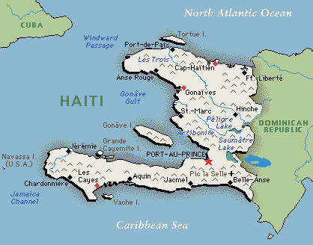
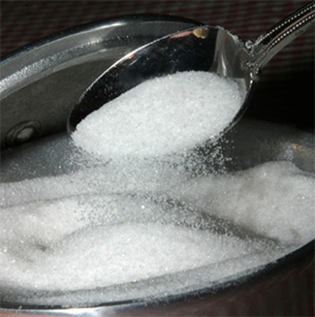
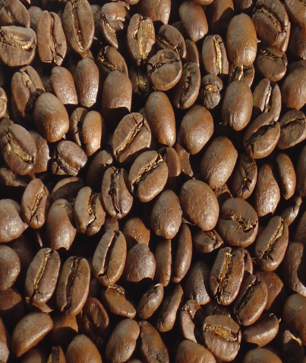
Haiti
Haiti = originally called Saint Domingue
French colony in the Caribbean
Colony’s purpose = plantations
Richest colony in the world at the time
8,000 plantations
Produced 40% of the world’s sugar
Produced 50% of the world’s coffee

Slide 3
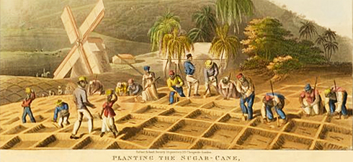
Haiti
About 500,000 of the 570,000 people living in Haiti = slaves
40,000 people = white people → divided between:
“Grands blancs” = wealthy plantation owners, merchants, and lawyers
“Petits blancs” = poor whites
30,000 people = free people of color

Slide 4
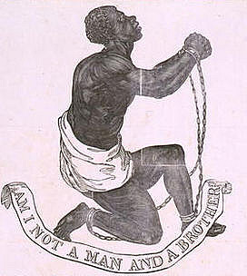
Haiti
All of these social groups were inspired by the French Revolution (but in different ways)
For “grands blancs” = meant greater independence for the colony from France and fewer trade restrictions
For “petits blancs” = meant equality of citizenship and economic opportunities
For free people of color = meant equal rights and treatment for all free people, regardless of race
For slaves = meant personal freedom

Slide 5
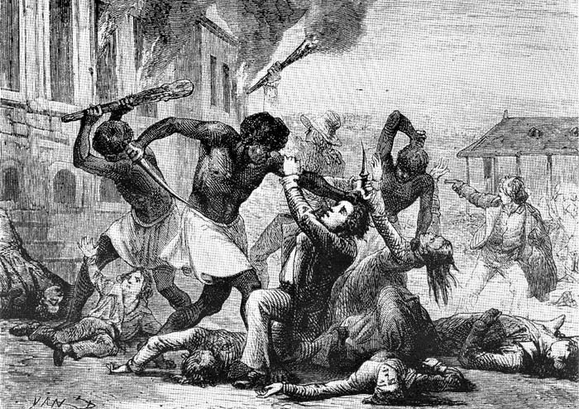
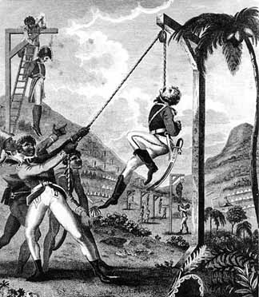
The Haitian Revolution
1791 = 1st massive revolt
Triggered by rumors that the French king had declared an end to slavery
Slaves burned around 1,000 plantations and killed hundred of white and mixed-race people

Slide 6
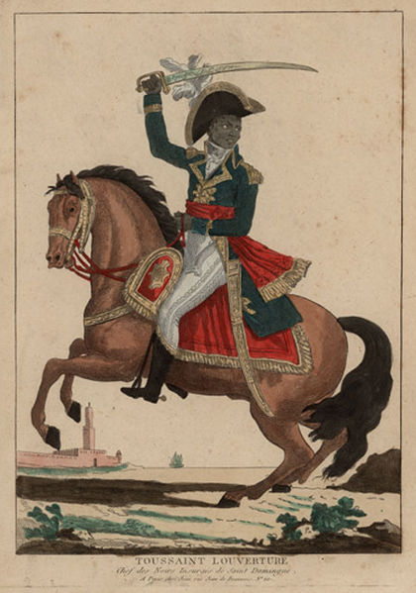
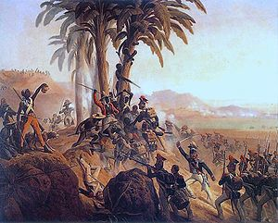
The Haitian Revolution
As the revolution continued, power gravitated toward the slaves
Led by Toussaint Louverture
A former slave

Slide 7
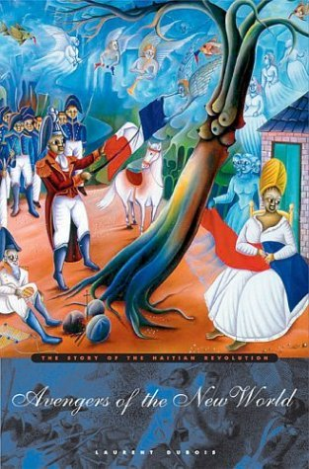
The Haitian Revolution
Only completely successful slave revolt in world history
Last had become first
Slaves became equal, free, and independent citizens almost immediately
Renamed their country “Haiti” = means “mountainous” or “rugged” in the language of the original inhabitants

Slide 8
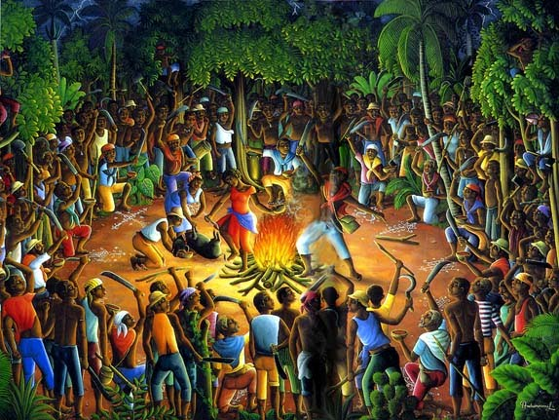
The Haitian Revolution
Formal declaration of independence = January 1, 1804
Effects:
Plantations destroyed
Most whites fled or were killed
Private and state lands redistributed among former slaves and free black people
Haiti became a nation of small-scale farmers producing for their own needs
A Celebration!

