Slide 1
The Enlightenment

Slide 2
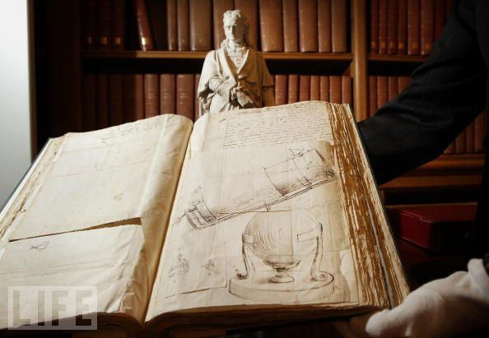
Science and Enlightenment
Popular interest in science spread throughout Europe
More people used science to explain the universe, not the Church
Monarchs set up academies, observatories, museums
Societies like Royal Society of London
Financial support to scientists
Published their works

Slide 3
Science and Enlightenment
Long-term outcome of scientific development = “enlightenment”
Enlightenment principles:
Human reason could be used to discover ways in which humankind could govern itself more effectively
Belief in the power of knowledge to transform human society

Slide 4
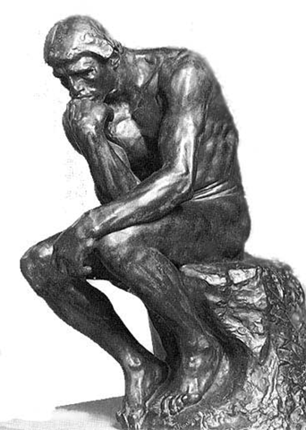
Science and Enlightenment
Ideas shared by Enlightenment thinkers:
Commitment to open-mindedness & inquiry
Critical nature
Hostility toward established religious and political authority (though in various degrees)

Slide 5
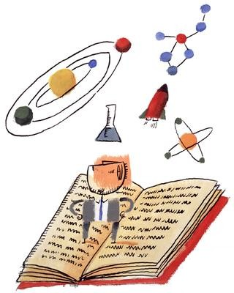
Science and the Enlightenment
Central theme of the Enlightenment = the idea of progress
Human society = not fixed by tradition or divine command
Can be changed and improved by human action guided by reason

Slide 6
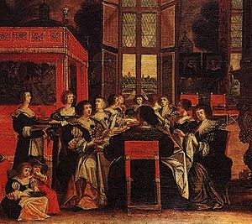
Spreading Enlightenment Ideas
Philosophes = thinkers of the Enlightenment who spread these ideas
Paris = active center of ideas
Salons = gatherings in the homes of wealthy patrons --> middle class writers, thinkers, and artists mingled with the nobility

Slide 7
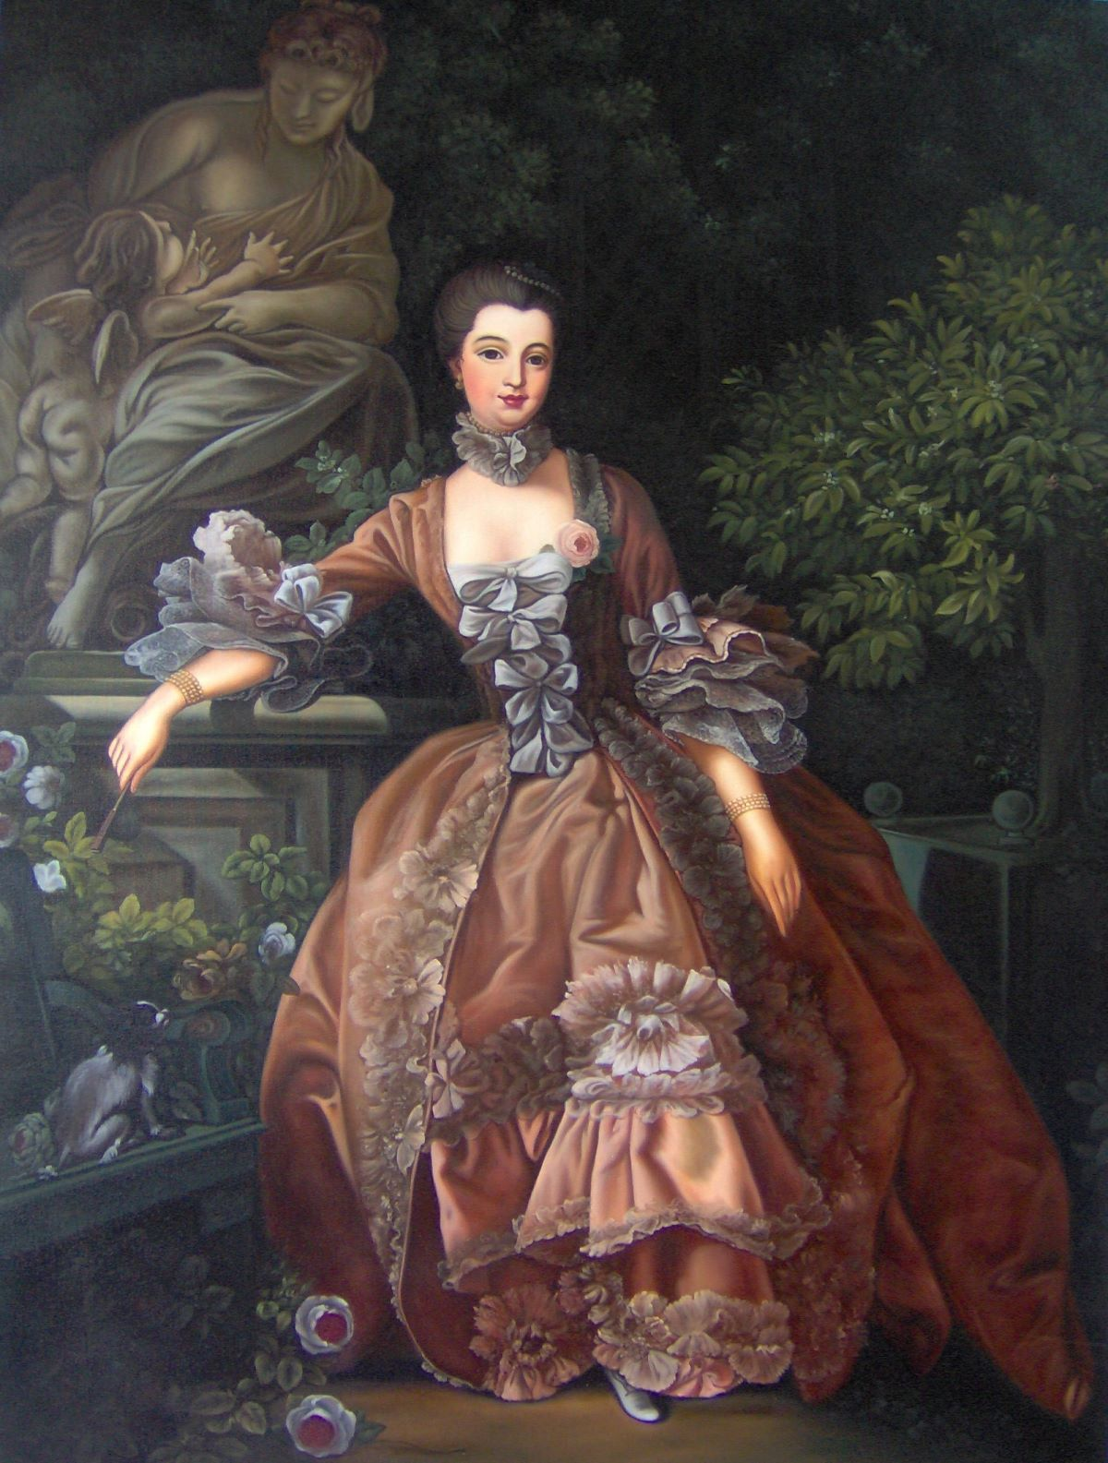
Spreading Enlightenment Ideas
Wealthy women ran the most popular salons
Most famous = Madame de Pompadour

Slide 8
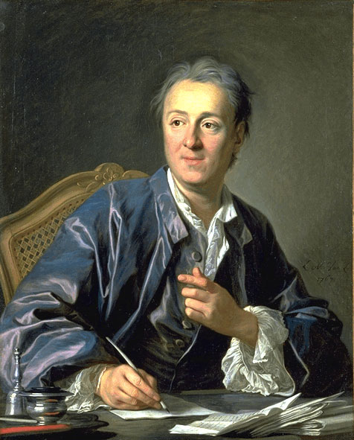
Spreading Enlightenment Ideas
1st Encyclopedia = edited by Denis Diderot
Contained articles from about 20 thinkers; illustrations; variety of topics
Criticized the Church
Diderot and others went to prison

Slide 9
Impact on Politics
Scientific thought & method influenced political theories
Political philosophers believed natural law could be understood by applying reason
Natural law = universal moral law

Slide 10
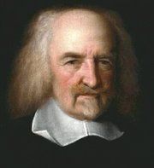
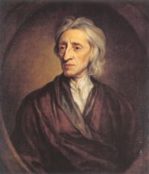
Impact on Politics
Thomas Hobbes vs. John Locke
In England at the time = struggle between those who wanted an absolute monarchy & those that wanted to govern themselves
vs.

Slide 11
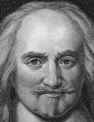
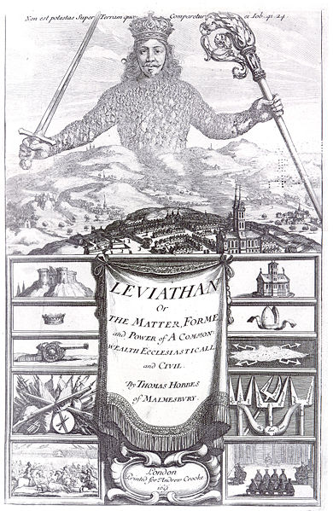
Thomas Hobbes
Absolute monarchy = best form of government
Violence & disorder = natural to human beings
Leviathan = book he wrote about a state in which people lived without government & it was brutal
People don’t have the right to rebel against the government or ruler

Slide 12
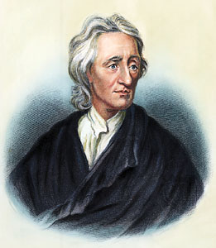
John Locke
People are naturally reasonable and moral
People have natural rights = rights granted at birth → life, liberty, and property

Slide 13
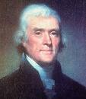
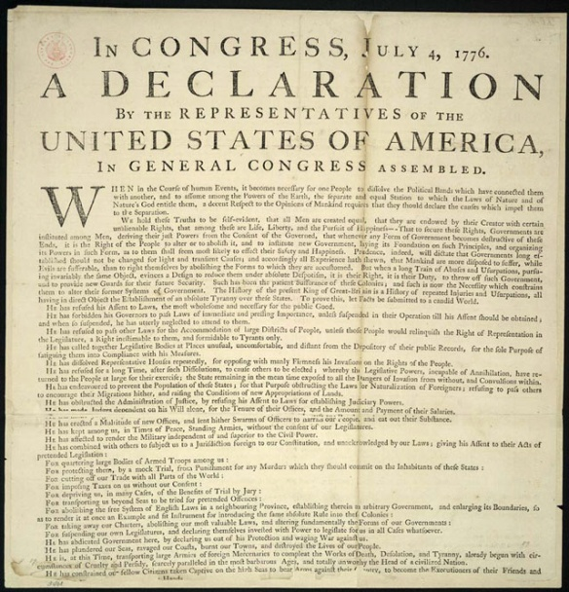
John Locke
Two Treatises on Government = essays he wrote that said:
1. People created the government to protect these natural rights
2. Government is responsible to the people
3. If the government doesn’t do it’s job, the people have the right to overthrow it
Influenced Thomas Jefferson when he wrote the Declaration of Independence

Slide 14
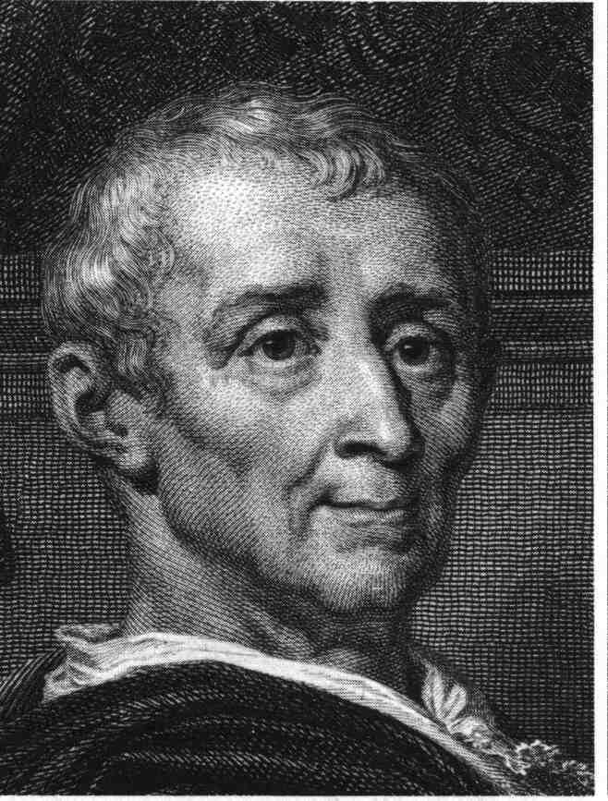
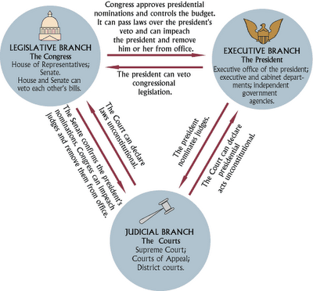
Montesquieu
Wrote The Spirit of the Laws
Studied various existing governments
Promoted democracy and separation of powers
Power should be equal among the branches; checks and balances
Influenced the U.S. Constitution

Slide 15
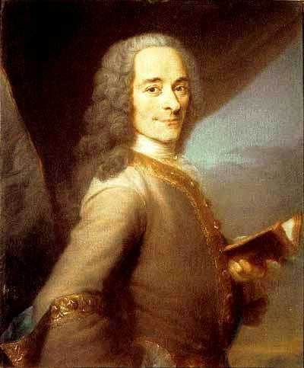
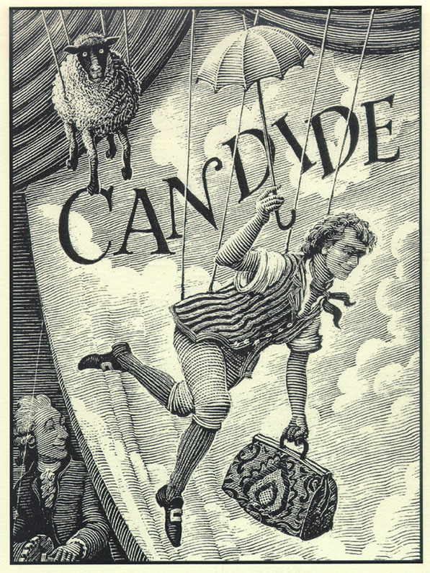
Voltaire
Wrote Candide = challenged the idea that “all is for the best in the best of all possible worlds”
Mocked the Church and the royal court
Promoted religious freedom, freedom of speech, and freedom of the press

Slide 16
Impact on Religion: Deism
Voltaire, along with many other Enlightenment thinkers practiced deism
Belief in an abstract and remote Deity
Deity created the world, but doesn’t intervene in history or tamper with natural law
This Deity = like an engineer → made the machine, but is now letting it run on its own

Slide 17
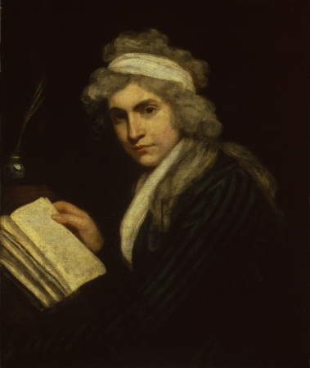
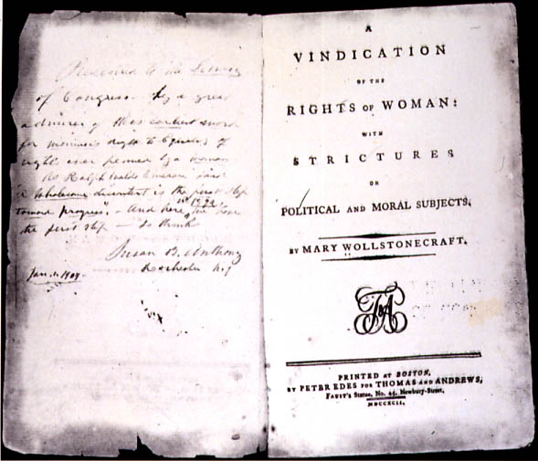
Women & the Enlightenment
At this time:
Ideas of equality and freedom didn’t apply to women
Women didn’t participate in public life like men
Women were limited to home and the family
Small groups of women began to speak out
Mary Wollstonecraft = wrote Vindication of the Rights of Women = favored equal education for women and men so both could contribute to society

Slide 18
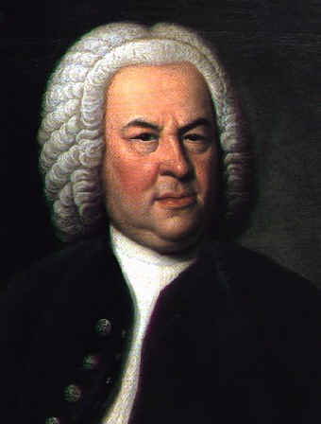
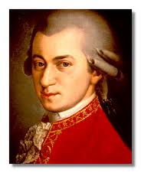
Impact on the Arts
Classical Movement = art going back to ancient Greek and Roman ideals that represented order and reason
Includes art, music, and literature → all reflected simplicity, clarity, and order
Famous classical composers = Wolfgang Amadeus Mozart and Johann Sebastian Bach

Slide 19
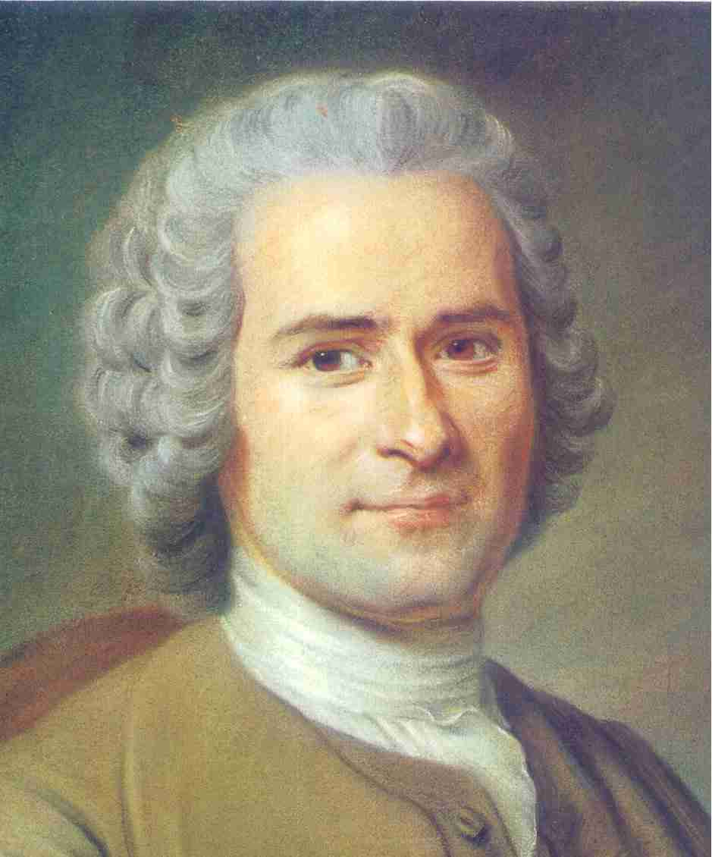
Opposition to the Enlightenment
Some saw this ordered view of the universe as overly rational and lacking emotion
Jean-Jacques Rousseau
People should rely more on emotion and instinct and less on book learning
Believed people are naturally good, but civilization and institutions corrupt them

Slide 20
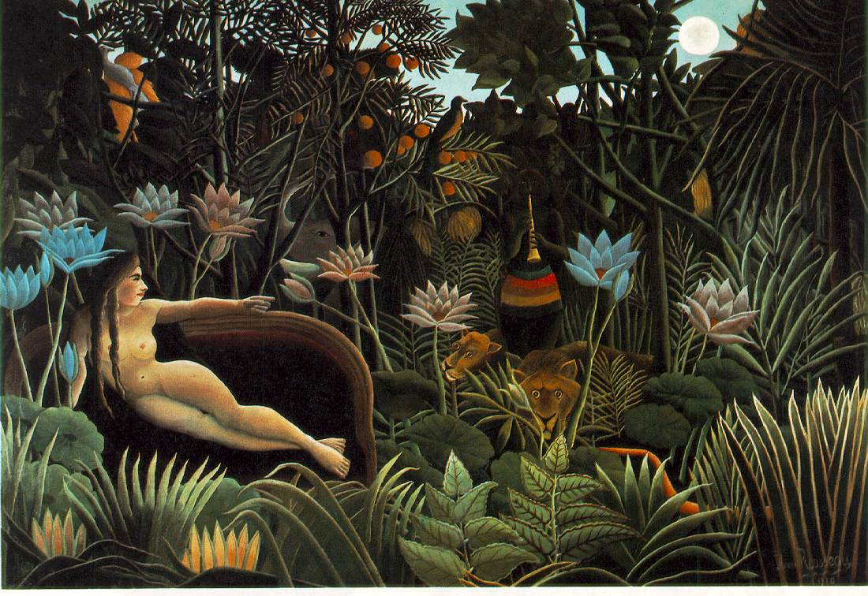
Jean-Jacques Rousseau
Urged getting rid of civilization and returning to a “state of nature”
The Social Contract = “man is born free, and he is everywhere in chains”
Basis of government = social contract in which people give up their individual rights to the “general will” of the majority
Government BY the people
Influenced democracy

Slide 21
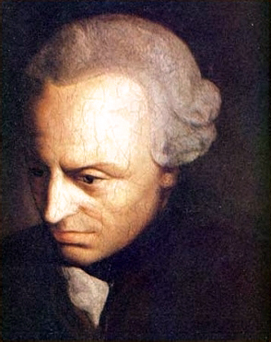
Immanuel Kant
Argued that reason couldn’t answer problems of metaphysics = philosophy that deals with spiritual issues like the existence of God
Reality = there’s a physical world and a spiritual world – and you need different methods for looking at each one
Physical world = knowledge through senses and reason
Spiritual world = knowledge through faith and intuition

Slide 22
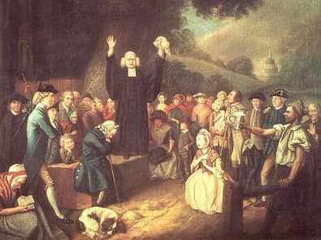
Impact on Religion
Many started to reject deism → wanted something more emotionally satisfying
Religious awakenings shook Protestant Europe and North America
Fiery sermons
Public repentance
Sharing intense personal experiences of sin and redemption

Slide 23
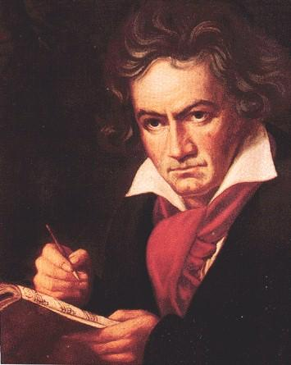
Impact on the Arts
Classicism in arts gave way to romanticism = celebrated emotion and the individual
Broke free of restraints
Famous Romantic composer = Ludwig von Beethoven

Slide 24
Looking Ahead: Science in the 19th Century
AP World History Notes
Chapter 16
Religion and Science (1450-1750)

Slide 25
Science in the 19th Century
Enlightenment ideas challenged by:
Romanticism
Religious “enthusiasm”
Continued development of science

Slide 26
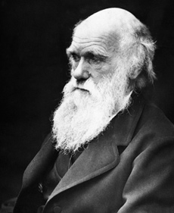
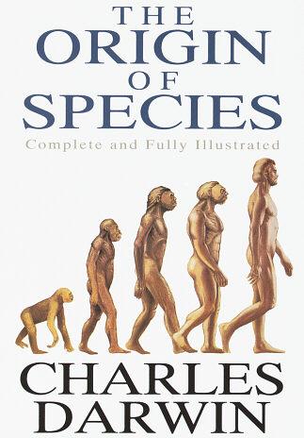
Charles Darwin (1809-1882)
Developed theories of natural selection and survival of the fittest
All of life is an endless and competitive struggle for survival
Constantly generates new species of plants and animals and throws others into extinction
Humans not excluded → also the product of evolution operating through natural selection

Slide 27
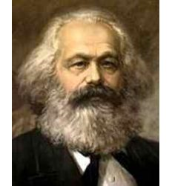
Karl Marx (1818-1883)
Argued that human history has been shaped by economic conflict and class struggles
Conflicting social and economic classes = push history forward
Did not believe in heavenly intervention, chance, or the “divinely” endowed powers of kings
In favor of socialism = means of production owned and controlled by society, either directly or through the government
Goal = wealth is distributed evenly amongst all people

Slide 28
Darwin and Marx
Like Enlightenment thinkers = Darwin and Marx believed in progress
UNLIKE Enlightenment thinkers = Darwin and Marx argued that conflict and struggle were the motors of progress, not reason and education

Slide 29
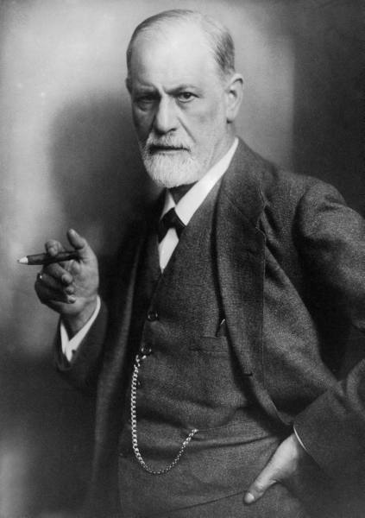
Sigmund Freud (1856-1939)
Applied scientific techniques to the operation of the human mind and emotions
Cast doubt on concept of human rationality
His argument = at the core of every person are primal impulses toward sexuality and aggression
Impulses = barely kept in check by our social conscience we derive from civilization
Our “neuroses” = come from the struggle between our irrational drives and our social conscience
Examples of neuroses = anxiety, OCD, depression, phobias, personality disorders, etc.

