Slide 1
The Cold War: Nuclear Standoff & Third World Rivalry

Slide 2
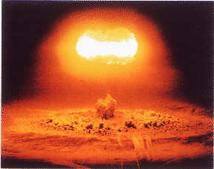
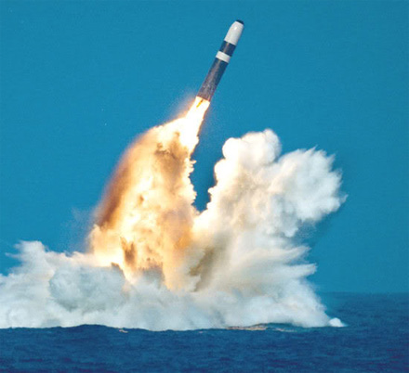
The Arms Race
Race to create and amass the most nuclear weapons
Atomic and hydrogen bombs
Hydrogen bombs = up to 1000 times more powerful than atomic bombs
Inter-continental ballistic missiles
Could launch numerous warheads across continents and oceans
Incredibly accurate
Any major city in the world could be obliterated within a matter of seconds
The threat of nuclear war was ever-present and the entire world lived in a constant state of fear

Slide 3
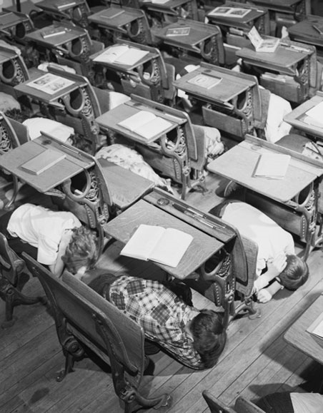
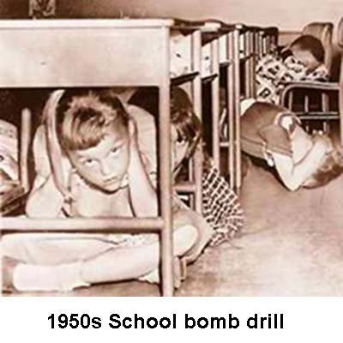
The Arms Race
The famous “Daisy” commercial from Lyndon Johnson’s 1964 presidential ad campaign

Slide 4
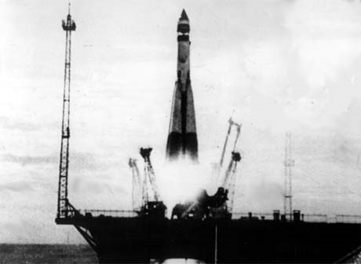
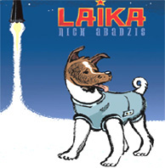
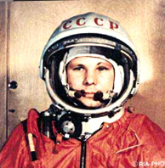
The Space Race
Both countries put emphasis on other technological research as well → especially space technology
Soviet Union = had 1st achievements
1957 = the Soviets launched Sputnik I = world’s first space satellite
1957 = the Russian space dog Laika was the first animal to orbit the earth
1961 = 1st man in space = Yuri Gagarin = from the Soviet Union
Soviet achievements stunned the U.S. and pushed America to further its space research

Slide 5
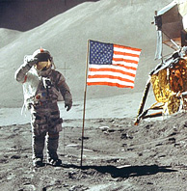
The Space Race
1963 = President Kennedy promised the world that the U.S. would land men on the moon before 1970
July 20, 1969 = Neil Armstrong and Buzz Aldrin took “one small step” on the moon

Slide 6
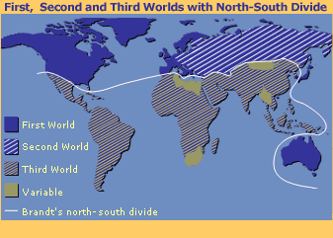
Battle for Third World Countries
The Soviet Union and the U.S. used military and economic aid, educational opportunities, and political pressure to “court” Third World countries
First World countries = countries of the developed West
Second World countries = communist countries
Third World countries = countries emerging from colonial rule
Soviet Union = wanted to spread communism
U.S. = wanted to “contain” communism
Sometimes led the U.S. to support anti-communist, but corrupt and authoritarian regimes

Slide 7
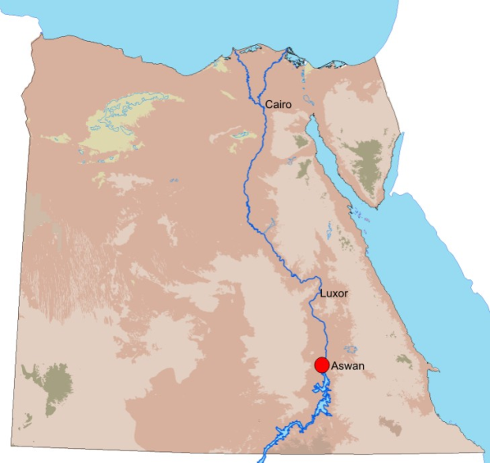
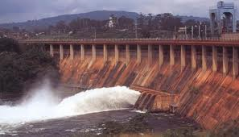
Battle for Third World Countries
Third World countries resisted the role of pawns in superpower rivalries → most took a stance of “nonalignment” in the Cold War
Neither superpower = able to dominate these third-world allies
Some Third World countries = tried to play off the superpowers against each other
Example: U.S. refused to help Egypt build the Aswan Dam in the mid 1950’s
Egypt turned to the Soviet Union instead and developed a close relationship with the USSR
1971 = Egypt expelled 21,000 Soviet advisors and aligned with the United States

Slide 8
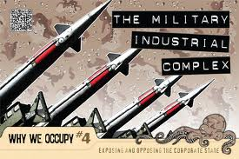
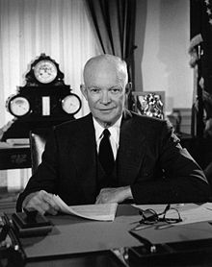
The U.S.: Superpower of the West, 1945-1975
Rise of a strong or “imperial” presidency and a “national security state” = the executive branch and defense/intelligence agencies acquired great power within the government
Growth of the “military-industrial complex” = a coalition of the armed services, military research labs, and private defense industries
Stimulated and benefited from increased military spending and Cold War tensions
President Eisenhower warned the U.S. of the dangers of the military-industrial complex in his farewell address

Slide 9
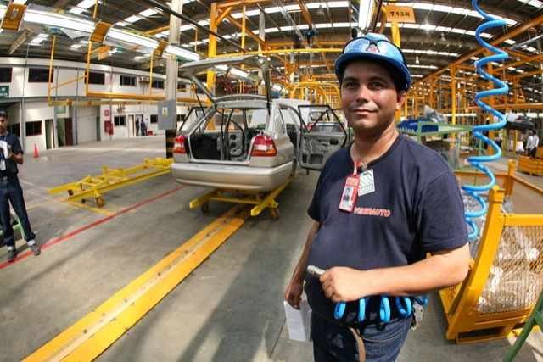
The U.S.: Superpower of the West, 1945-1975
Bustling U.S. economy → most productive economy in the world
Everyone wanted American goods, which began to be sold on a massive scale worldwide
Americans also sent capital abroad
American firms such as GM, Ford, Mobil, Sears, General Electric, and Westinghouse set up factories, offices, and subsidiaries worldwide and sold their goods locally
A Ford factory in Valencia, Venezuela; opened in 1962; still open today

Slide 10
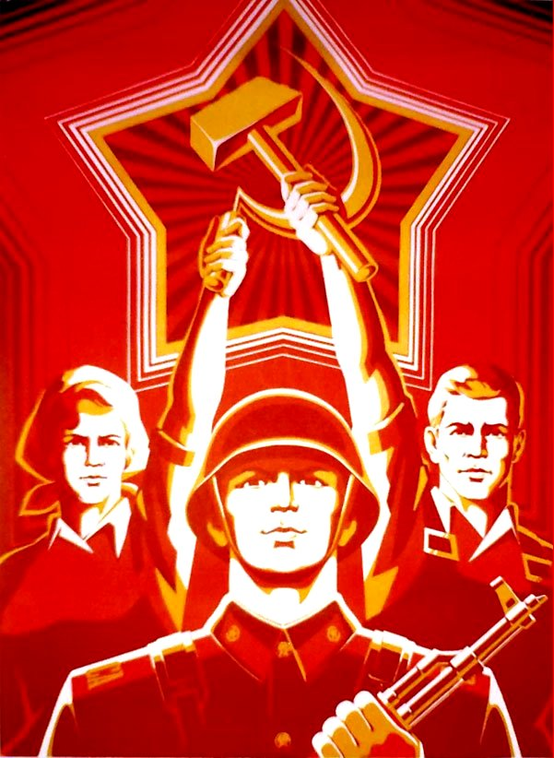
The Communist World, 1950s-1970s
On the communist side, the Cold War was accompanied by turmoil both within and among communist states
“Metal-eater’s alliance” = Soviet version of the military-industrial complex
Joined the armed forces with certain heavy industries to press for a weapons buildup that benefited both
Emphasis on military and defense industries
Soviet Propaganda Poster
(Notice how the soldier is front and center)

Slide 11
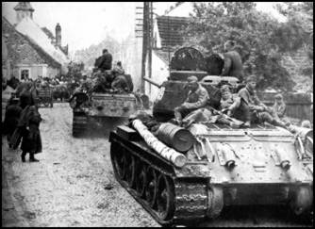
The Communist World, 1950s – 1970s
Communist goal worldwide was that “workers of the world” would unite, eroding national loyalties
Unite in common opposition to global capitalism
This never happened → too many divisions
Many Eastern European nations rejected Soviet domination over their affairs
Independence and reform movements began in many of these countries
1956-1957 = Soviet forces invaded its own “allies” Hungary and Czechoslovakia to crush such movements
1980s = Soviet forces did the same thing in Poland
Soviet forces in Hungary in 1956

Slide 12
The Soviet Union versus China
Sharply opposed → territorial disputes, ideological differences, and rivalry for communist leadership
China | Soviet Union
Criticized Khrushchev for backing down in the Cuban Missile Crisis Developed its own nuclear capabilities in the 1960s | Thought Mao Zedong was dangerously indifferent to the consequences of nuclear war 1960 = backed out of a promise to provide China with a prototype of the atomic bomb - Withdrew Soviet advisors and technicians who were helping China with nuclear developments

Slide 13
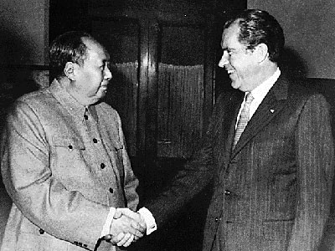
The Soviet Union versus China
By the 1960s = the two were at the brink of war with each other
Soviet Union even hinted at a possible nuclear strike on Chinese military targets
U.S. had to get involved with a “triangular diplomacy” to ease tensions between the two
President Nixon meeting with Mao Zedong in China

