Slide 1
Russian and Chinese Empire-Building [1450-1750]
Russia and Qing

Slide 2
Making the Russian Empire
Russian state centered on the city of Moscow
Conquered a number of neighboring Russian-speaking cities
Continued to expand south and east of Moscow
Brought together a wide variety of different peoples and cultures

Slide 3
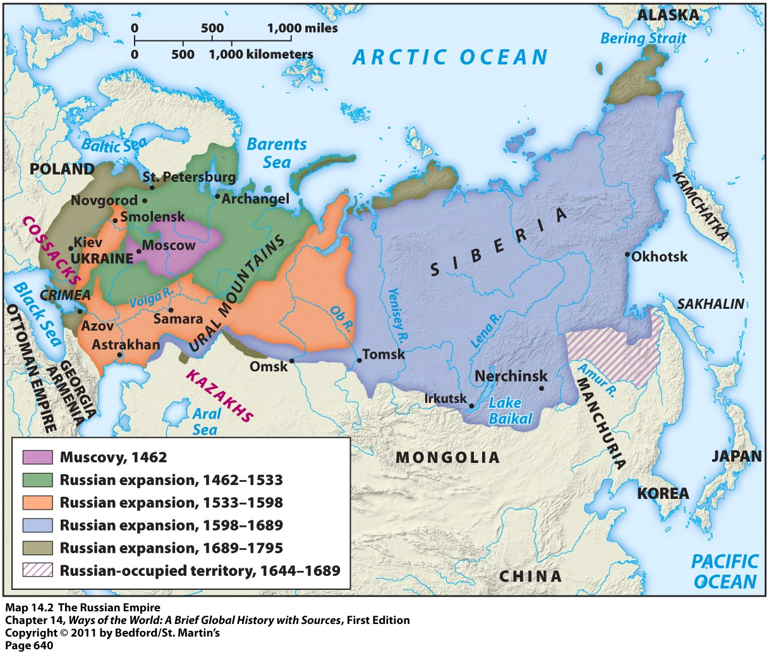
Making the Russian Empire

Slide 4
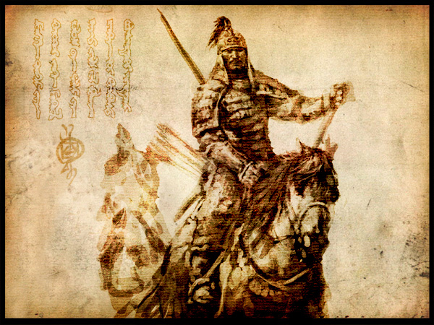
Motivations for Russian Expansion
Motivation #1 = security from the nomadic pastoral peoples
Lived in the grasslands south and east of the Russian heartland
Russians = afraid one of these groups will rise to power like the Mongols
These nomads frequently raided Russia’s neighbors and sold many of them into slavery

Slide 5
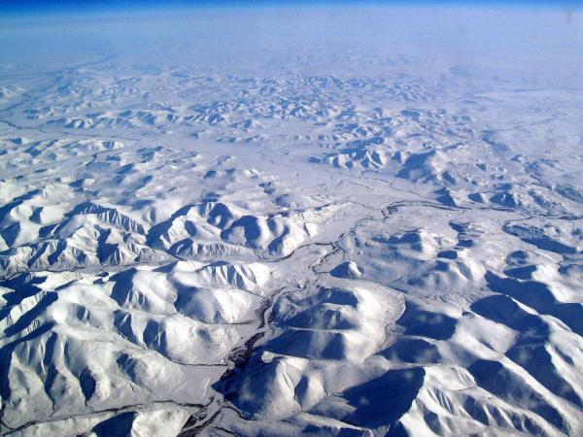
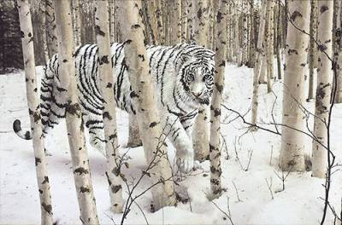
Motivations for Russian Expansion
Motivation #2 = Pelts of fur-bearing animals
To the east across the vast expanse of Siberia
Very valuable and in-demand item
Nickname = “soft gold”

Slide 6
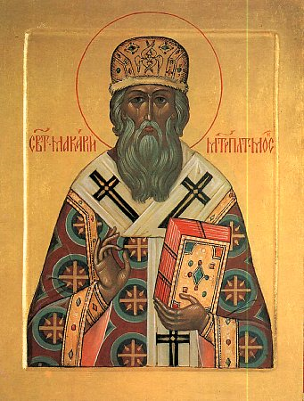
Russian Point of View
To Russians, their empire meant:
Defending the Russian frontiers
Enhancing the power of the Russian state
Bringing Christianity, civilization, and enlightenment to “savages”

Slide 7
Ivan III, the Great (1462-1505)
In the 15th C, grand princes of Moscow continued to increase land,population, and wealth
Laid foundations of Russian national state
Fall of Constantinople and emergence of New Rome and seat of Orthodox Christianity
Proclaimed his absolute sovereignty over all Russian princes and nobles
Refused further tribute to Tatars

Slide 8
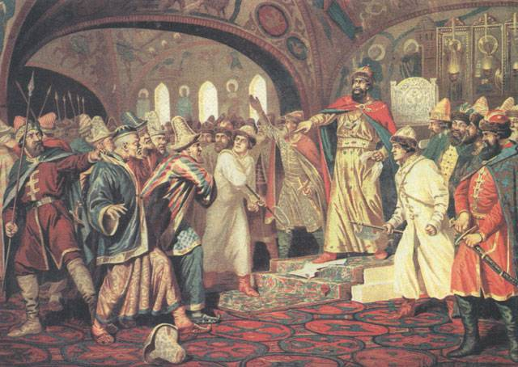
Ivan the Great (r. 1462-1505)
Ivan III Tearing the Great Khan’s Letter Requesting More Tribute in 1480.

Slide 9
Ivan III, The Great
Divided into khanates and hordes
Manor system and creation of expanding military control
Ivan III forced lesser princes to accept him and his successors as unquestioned rulers over military, judicial, and foreign affairs
Gradually, Russian ruler emerged as a powerful, autocratic ruler, a tsar or Ceasar

Slide 10
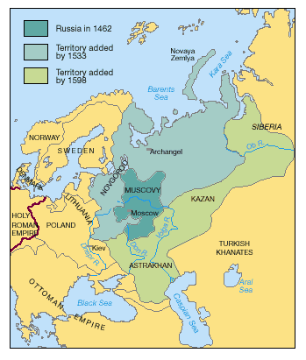
The Rise of Russia

Slide 11
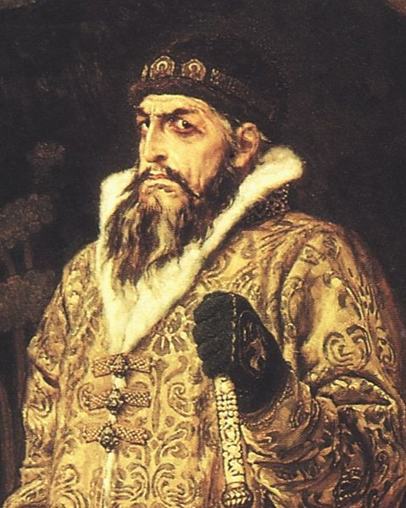
Life in the Russian Empire
Everyone had to swear an oath of allegiance to the grand tsar
Everyone had to pay yasak = tribute paid in cash or valuable goods
New diseases accompanied Russian conquest → ex: smallpox and measles
People felt the pressure to convert to Christianity
Tax breaks, tribute exemptions, and the promise of land if they did
Ivan the Terrible
Tsar of Russia (1533-1584)

Slide 12
Ivan IV r.1533-1584*
Ivan IV Vasilyevich-the Grand Prince of Moscow from 1533 to 1547
His long reign saw the conquest of Tartary and Siberia and the subsequent transformation of Russia into a multiethnic state.

Slide 13
Tsardom of Russia
First Russian ruler to officially crown himself “Tsar” was Ivan IV (The Terrible)
1547-1584-Tzar not Prince
Subordination of nobles, exiling many, and executing many
Enduring legacies both positive and negative

Slide 14
Cathedral of the Intersession
St. Basil’s Cathedral
Mark victory over the Khazan Khanate
8 days of battle
Onion domes
Expansion of Russian power

Slide 15
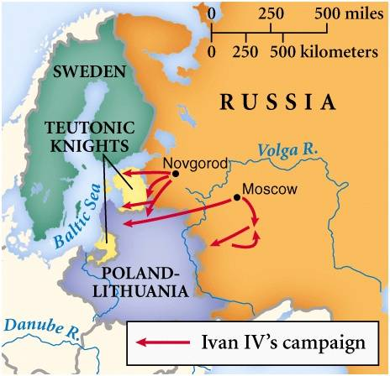
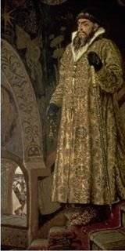
Russia in the Late 1500s
Ivan “The Terrible” (r. 1533-1584)

Slide 16
Ivan IV r. 1533-1584
complex personality; described as intelligent and devout, yet given to rages and prone to episodic outbreaks of mental illness.
One notable outburst may have resulted in the death of his groomed and chosen heir Ivan Ivanovich, which led to the passing of the Tsardom to the younger son: the weak and possibly intellectually disabled Feodor
Although his name is usually written in English as Ivan the Terrible, its original meaning is closer to "Redoubtable" or "Severe" and carries connotations of might, power and strictness rather than horror or cruelty

Slide 17
The “Time of Troubles”
Russian Inquisition left thousands dead
Rampant famine, grass, cannibalism?
Ivan IV murdered his son and daughter-in-law who was carrying his grandson
No true successor to crown
Internal chaos attracts Polish-Lithuanian intervention and installment of “tsars”
Between 1598-1610, Six different “tsars”
Vast lands acquired under Ivan III lost
Who will unit the Lands of the Rus?

Slide 18
The Russian Empire
By the 18th century = Russia became one of the great powers of Europe
Power stemmed from wealth found in: rich agricultural lands, valuable furs, and mineral deposits
Russia became a highly militarized state as well
Russian Empire stayed intact until the collapse of the Soviet Union in 1991

Slide 19
The Russian Empire
Established a tradition of autocratic government with a powerful monarchy
Belief = only a strong ruler could hold together such a large empire with such a diverse population
Ruled by monarchies until the early 1900s
Peter the Great
Reign: 1682 - 1725

Slide 20
Peter I, the Great
Consolidated autocracy in Russia and brought country into European state system
Largest state in the world from Baltic to Pacific Ocean
Window to the sea and the Great Northern War
New Capital, St. Petersburg, a window opened to Europe to replace the cultural center of Moscow

Slide 21
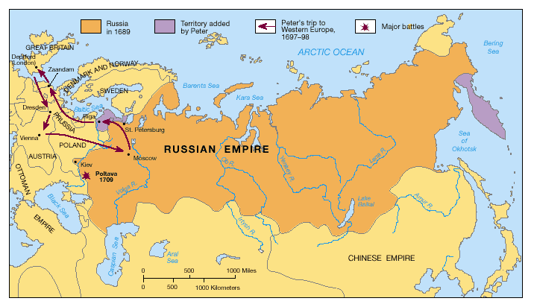
Russia Under Peter I

Slide 22
Russian Empire vs. those of other Western European Countries
Russian Empire
Other Europeans
Acquired territories next to them that they had been in contact with for a long time
Acquired territories at the same time that a Russian state was taking shape
“Russia was an empire.”
Acquired territories far away from them that they didn’t know about until 1492
Acquired overseas empires AFTER establishing themselves as solid European states
“The British had an empire.”

Slide 23
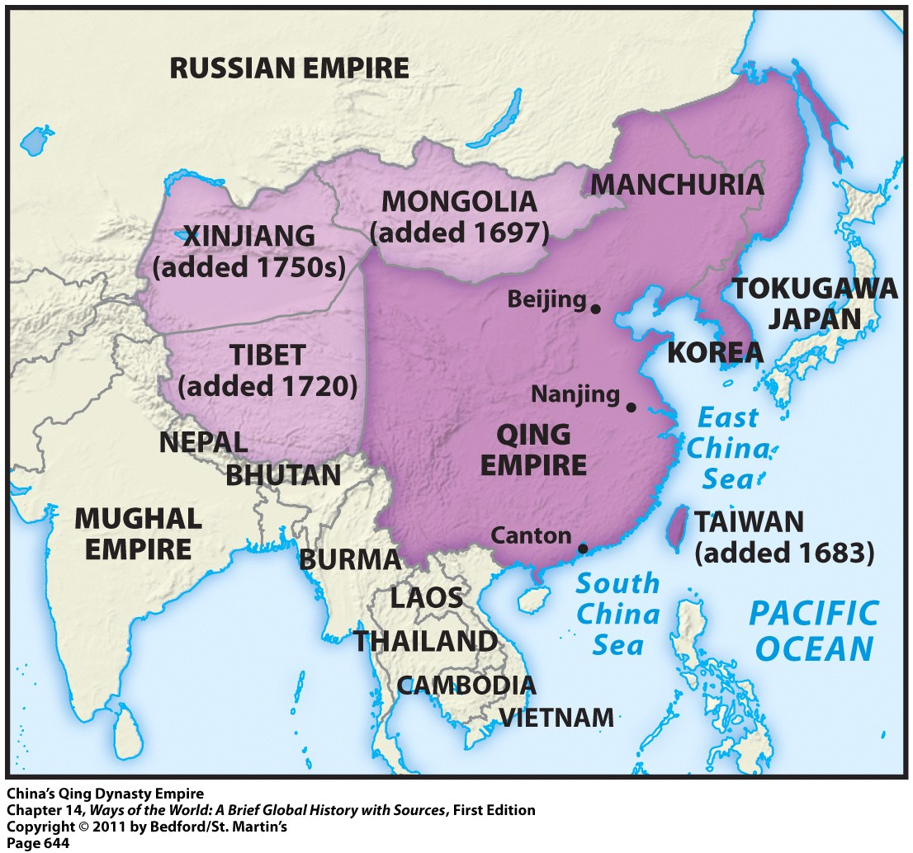
Making China an Empire
Done by the Qing (aka Manchu) Dynasty
Ruled from 1644 to 1912
Foreigners → invaders from Manchuria
Enlarged the size of China and incorporated a lot of non-Chinese peoples as they expanded to the north and west

Slide 24
Qing Rulers: Cultural Elements
Maintained
Adopted
Ethnic distinctiveness → forbade intermarriage between themselves and native Chinese
Chinese language
Confucian teachings
Chinese government techniques

Slide 25
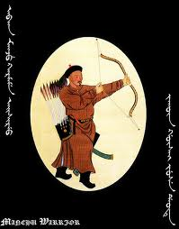
Making China an Empire: Motivations
Major motivation = security concerns
To China = expansion was viewed as a defensive necessity
Result = Qing dynasty China undertook an 80-year military effort (1680-1760) to bring together surrounding regions under Chinese control

Slide 26
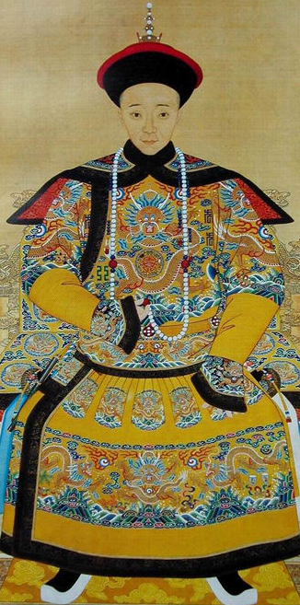
Life in the Chinese Empire
In general the Qing rulers:
Showed respect for other cultures
Did not force people to assimilate to Chinese culture
Chinese settlers did not flood the other regions of the empire
Yizhu = 8th Emperor of the Qing (Manchu) Dynasty

