Slide 1
The Protestant Reformation

Slide 2
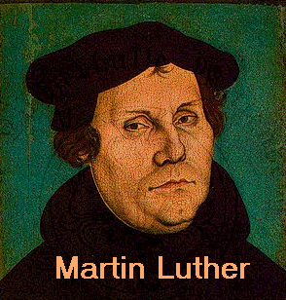
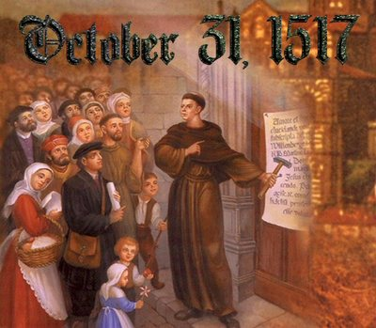
The Protestant Reformation
Started in 1517 by a German priest named Martin Luther
Causes:
Church Corruption
Selling of Indulgences
1/3 of land in Europe owned by Church
Nepotism- promoting of family w/n church
Simony- selling church offices
Issued a document called the 95 Theses
Nailed it to a church door in Wittenberg, Germany
Outlined his issues with the Catholic Church
#27. They are wrong who say that the soul flies out of Purgatory as soon as the money thrown into the chest rattles.
#62. The true treasure of the Church is the Holy Gospel of the glory and grace of God.
# 66. The treasures of indulgences are nets, wherewith they now fish for the riches of men.
# 86. Again; why does not the Pope, whose riches are at this day more ample than those of the wealthiest of the wealthy, build the Basilica of St. Peter with his own money rather than with that of poor believers.

Slide 3
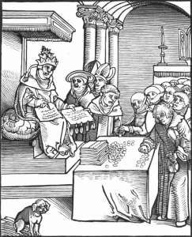
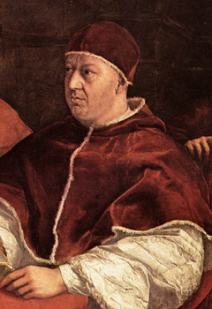
The Protestant Reformation
Martin Luther was critical of the following abuses conducted by the Catholic Church:
Selling church positions
Selling indulgences = certificates issued by the church that reduced or canceled punishment for a person’s sins → people would buy them to ensure going to Heaven
Luxurious life of the popes
Corruption and immorality of some clergy
The selling of indulgences
Pope Leo X (above) sold church positions and indulgences to raise money to rebuild St. Peter’s Basilica in Rome

Slide 4
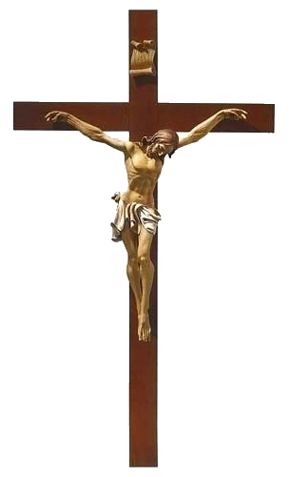
Martin Luther’s Beliefs
Salvation = came through faith alone; God’s grace is freely and directly granted to believers
Source of religious authority = the Bible (as interpreted by the individual), not the Pope or church leaders
These ideas = created a massive rift between Catholic and Protestant Christianity

Slide 5
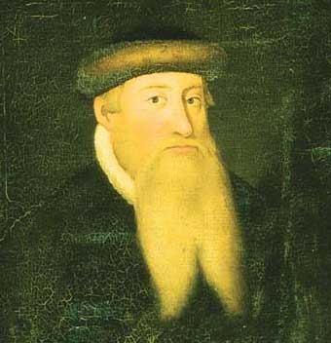
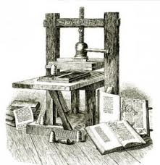
Spread of Protestantism
Reformation thinking spread quickly within and beyond Germany thanks to the invention of the printing press by Johannes Gutenberg
Luther’s 95 Theses, many pamphlets, and his German translation of the New Testament were soon widely available
As the movement spread to the rest of Europe, it splintered, creating a variety of different Protestant churches
Ex: Lutheran, Calvinist, Anglican, Quaker, Anabaptist, Puritan, etc.

Slide 6
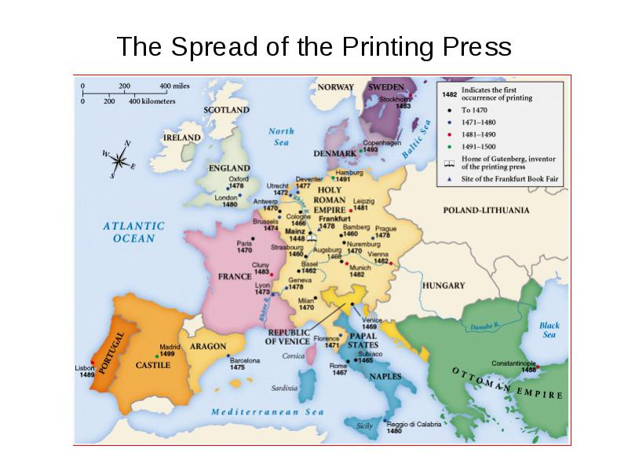

Slide 7
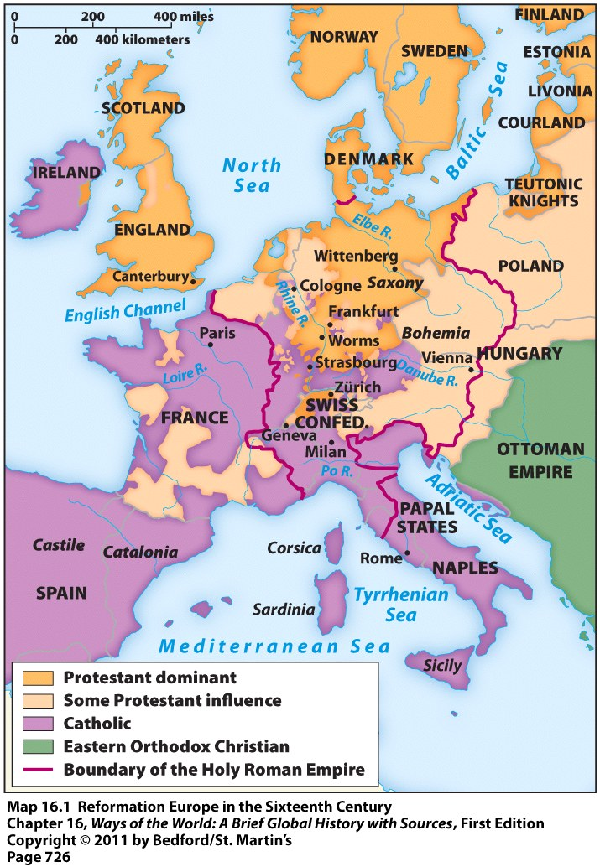
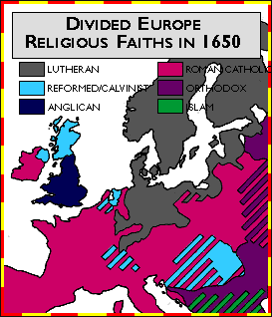
Spread of Protestantism

Slide 8
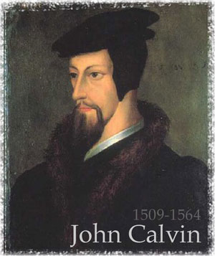
Calvinism
Established by John Calvin in Switzerland
Preached predestination = God determines the fate of every person

Slide 9
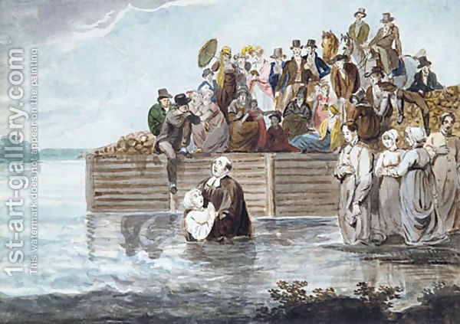
The Anabaptists
Denied the authority of local governments
Refused to hold office, bear arms, or swear oaths
Many lived separate from society → viewed it as sinful
Baptized adult members only
An Anabaptist Immersion

Slide 10
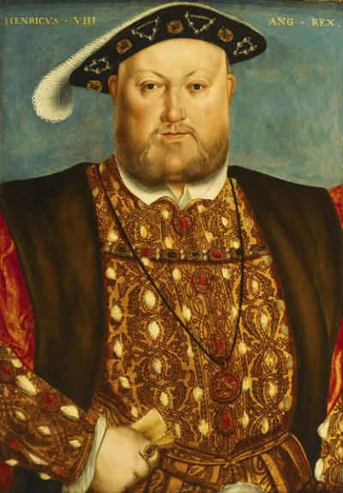
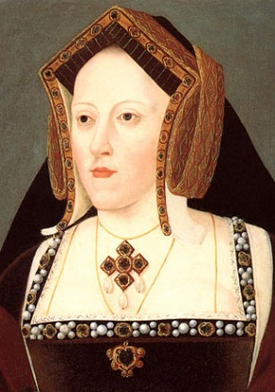
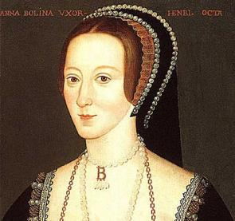
The Church of England
King Henry VIII (ruled from 1509-1547) wanted a divorce from his first wife (Catherine of Aragon)
She had 6 children -- only 1 survived (a girl named Mary)
King wanted a male heir to the throne
King thought Catherine of Aragon was too old and he wanted to marry the young, beautiful Anne Boleyn instead
Problem = the Pope refused to grant the King a divorce

Slide 11
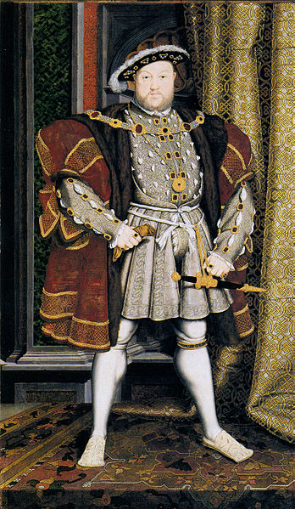
The Church of England
Result = Henry VIII separated England from the Pope and the Catholic Church
Made himself head of the new “Church of England”
Kept Catholic practices & traditions, but denied authority of the Pope
Had supporters of the old religion killed

Slide 12
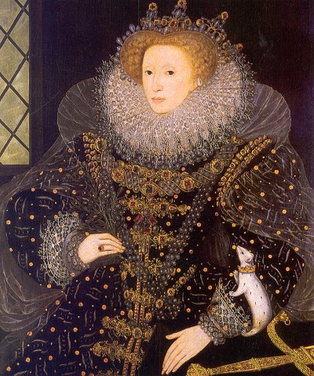
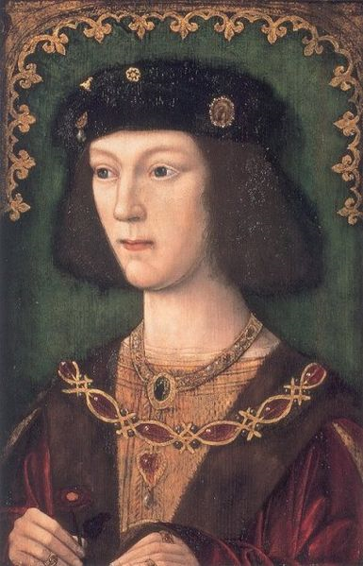
The Church of England
King Henry VIII had the Church of England end his marriage with Catherine & he married Anne Boleyn
Anne bore him a daughter = Elizabeth I
Henry VIII married 4 more times after this & only got 1 son = Edward VI (got the throne, but died in his teens)

Slide 13
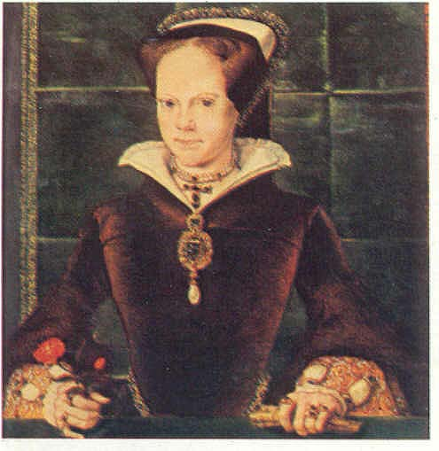
The Church of England
Henry’s daughter Mary tried to restore Catholicism when she became Queen
Burned hundreds of Protestants at the stake
Nicknamed “Bloody Mary”

Slide 14
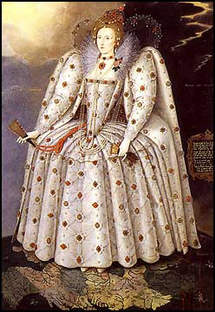
Anglicanism
Mary’s sister Elizabeth I became Queen when Mary died → blended features of the Church of England and Catholicism
Religion called Anglicanism
Pleased most people
Radical Protestants called “Puritans” wanted to purify the English Church of all its Catholic elements → ended up leaving for North America where they could have more religious freedom

Slide 15
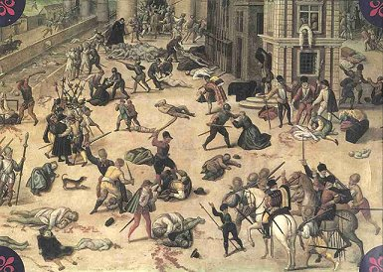
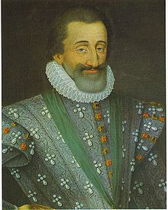
Religious Conflicts
1562 – 1598 = violent conflict between Catholics and Protestants in France
French Protestants = called Huguenots = the minority
In one day (in 1572) = about 3,000 Huguenots were massacred by Catholic mobs
1598 = King Henry IV issued the Edict of Nantes
Granted religious toleration to French Protestants
Idea = soon they’d return to the Catholic Church
Massacre of the Huguenots, 1572

Slide 16
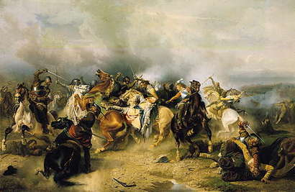
Religious Conflicts
Thirty Years’ War (1618-1648) = war between Catholics and Protestants
Started in Holy Roman Empire; soon took over most of Europe
Destructive war
15-30% of German population died from violence, famine, or disease
1648 = Peace of Westphalia signed
Redrew some European political boundaries
Said each state was independent and could control its own religious affairs
Painting of the Beginning of the 30 Years’ War

Slide 17
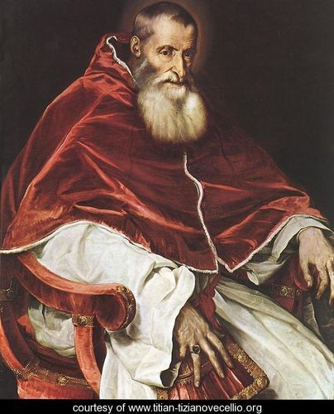
Catholic Counter-Reformation
Pope Paul III wanted to reform the Catholic Church to win back followers and stop the growth of Protestant faiths
Council of Trent (1545-1563)
Reaffirmed Catholic teachings and practices
Put an end to Church abuses, such as the selling of indulgences and church positions
Put emphasis on creating a better-educated clergy

