Slide 1
Ming China
Exploration and Zheng He

Slide 2
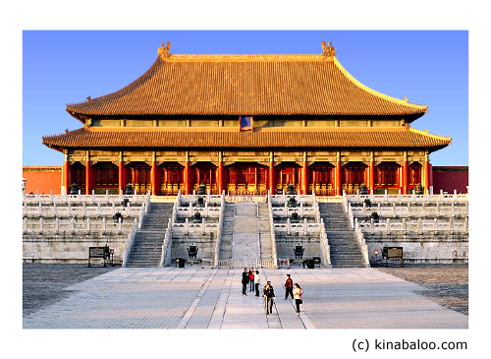
Ming China
Capital = Beijing
Emperor Yongle built the Forbidden City = magnificent imperial residence
Also built the Temple of Heaven = where rulers performed Confucian-based rituals to ensure the well-being of Chinese society

Slide 3
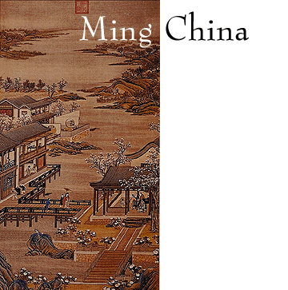
Ming China
Focus = repairing the damage caused by Mongol rule
Restored millions of acres of cultivation
Rebuilt: canals, reservoirs, and irrigation systems
Planted millions of trees to reforest China

Slide 4
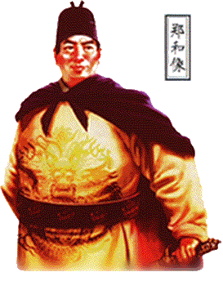
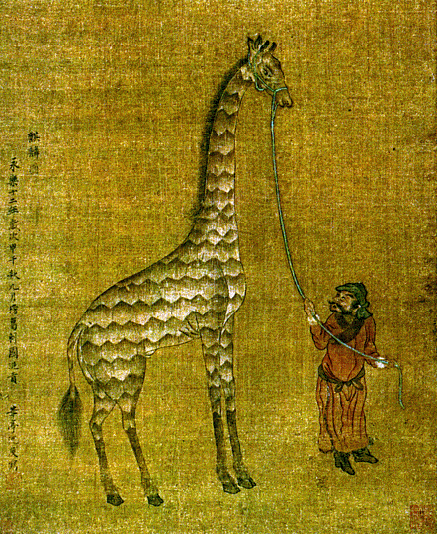
Chinese Exploration
China undertook large and impressive maritime expeditions
Largest = launched in 1405 and led by Zheng He
300 ships; 27,000 crew members; variety of different people on board
He made 7 voyages between 1405 and 1433

Slide 5
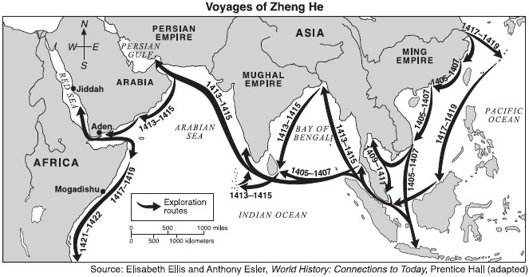
Voyages of Zheng He

Slide 6
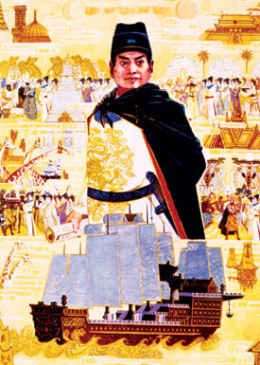
Chinese Exploration
Goals of Chinese exploration:
Enroll distant peoples and states in the Chinese tribute system
Bring back exotic goods from foreign lands (ex: zebras, giraffes, etc.)
Establish Chinese power and prestige in the Indian Ocean
Exert Chinese control over foreign trade

Slide 7
Chinese Exploration
Abrupt and deliberate end to Chinese exploration in 1433
WHY?
Death of Emperor Yongle = chief supporter
Many officials saw expeditions as a waste of money and resources
Believed focus should be on real threat = nomads to the north

