Slide 1
Independence and Development in the Global South

Slide 2
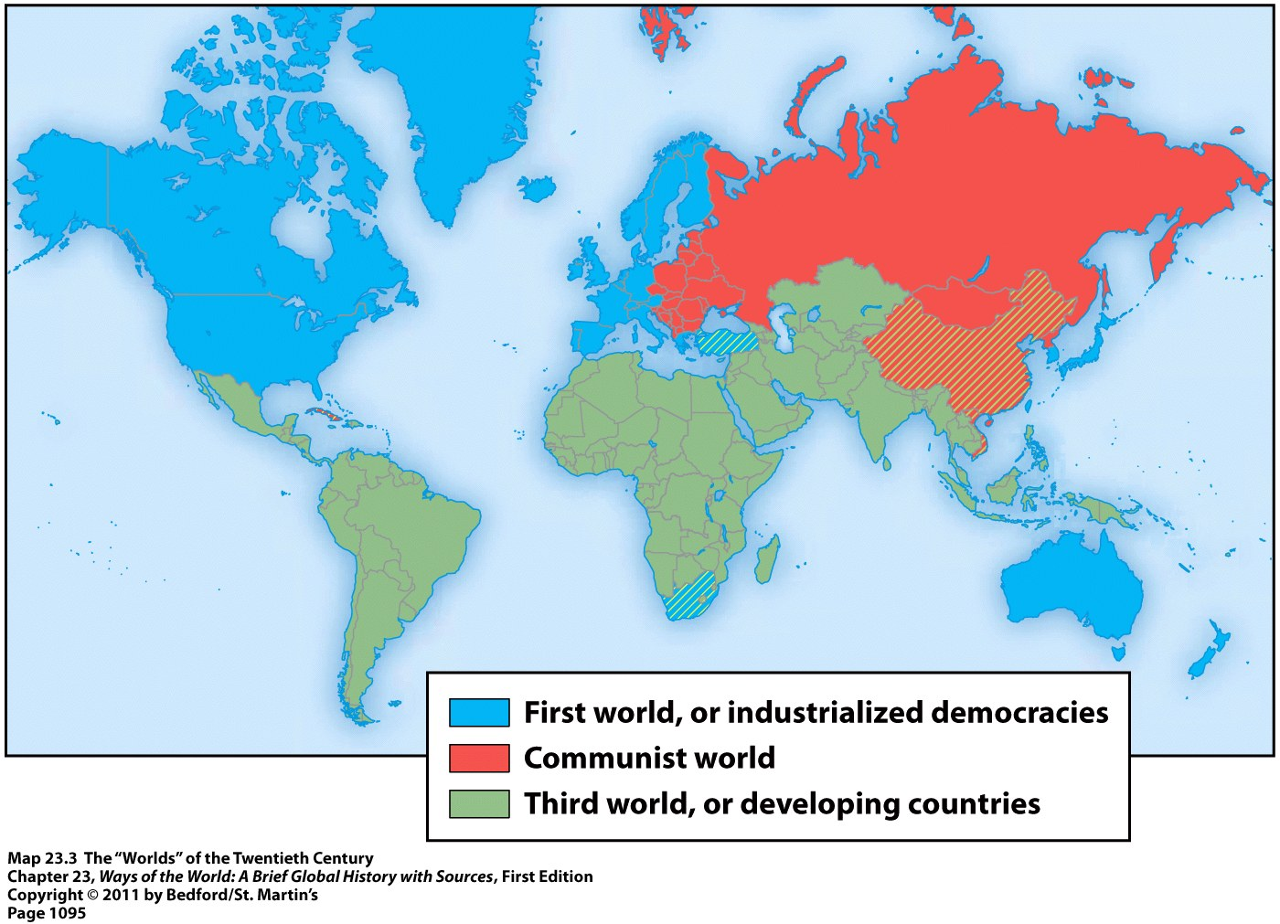
The Global South
“The Global South” = formerly labeled “third-world countries” during the Cold War → now often referred to as “developing nations”
“Decolonization” = term for the Global South’s independence from European rule

Slide 3
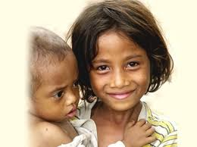
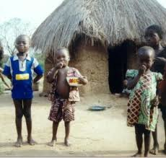
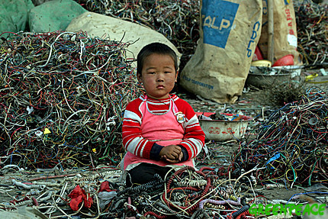
The Global South
Challenges facing the Global South after decolonization:
The legacies of empire
Deep divisions of language, ethnicity, religion, and class
Rapidly growing populations
Competing demands of the capitalist West and the communist East
Developing economies, stable politics, and coherent nations all at the same time

Slide 4
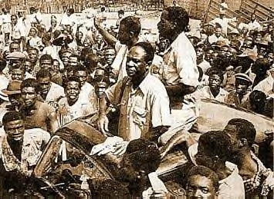
The End of Empire in World History
Dissolution of empires = nothing new
Think about the end of older empires → Assyrians, Greeks, Romans, Arabs, Mongols, etc.
What’s different about the end of these empires?
Mobilization of the masses within the colonies around a nationalist ideology
Creation of a large number of independent nation-states following the empire’s breakdown → each claiming an equal place in the world
Kwame Nkrumah after leaving prison in 1951
Led Ghana to national
independence in 1957

Slide 5
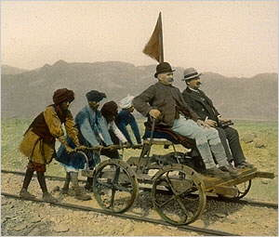
Independence of India
British colonial rulers promoted a growing sense of “Indian” identity:
British never assimilated into Indian society, unlike rulers in the past → had a sharp sense of racial and cultural distinctiveness
India’s many regions and peoples bound together by: British railroads, telegraph lines, postal services, administrative networks, newspapers, schools, and the English language

Slide 6
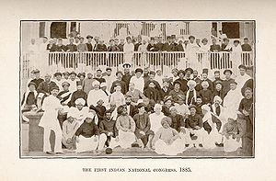
Indian National Congress
Indian National Congress (INC) = established in 1885
Association of English-educated Indians = lawyers, journalists, teachers, businessmen, etc.
Based in the cities
Had difficulty gaining a mass following among the peasants because such an elite organization
Initial goal = to gain greater inclusion within the political, military, and business life of British India
NOT the overthrow of British rule

Slide 7
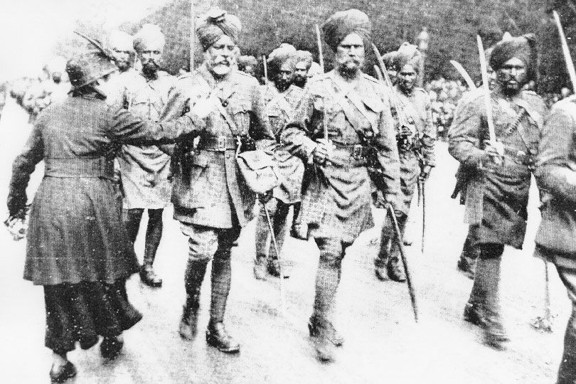
Indian National Congress
More Indians began to join the INC after:
WWI → the British had promised Indians more self-governing institutions if they helped in WWI
British attacks on Ottoman Empire in WWI → upset India’s many Muslims
Flu epidemic hit India after WWI → millions of Indians died
Repressive actions by British rulers
Ex: about 400 Indians killed who defied a ban on public meetings
Indian troops fighting on behalf of Great Britain in World War I

Slide 8
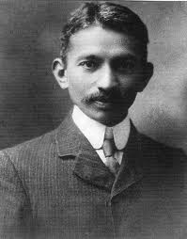
Mohandas Gandhi
1893 = accepted a job with an Indian law firm in South Africa
Witnessed overt racial segregation for the first time
Organized Indians (mostly Muslims) in South Africa to protest these policies of racial segregation
Developed a concept of a free India that included Hindus and Muslims alike
Developed political philosophy called satyagraha (truth force) = confrontational, though nonviolent, approach to political action
Gandhi as a young lawyer in South Africa

Slide 9
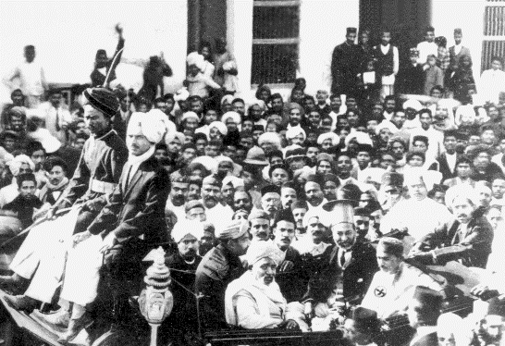
Mohandas Gandhi
1914 = Gandhi returned to India and became a leader in the INC
Gandhi’s simple and unpretentious lifestyle, support of Muslims, frequent reference to Hindu themes, and nonviolent approach drew support from a wide range of Indians:
Peasants and the urban poor
Intellectuals and artisans
Capitalists and socialists
Hindus and Muslims
The INC became a mass organization
Gandhi back in India (1915)

Slide 10
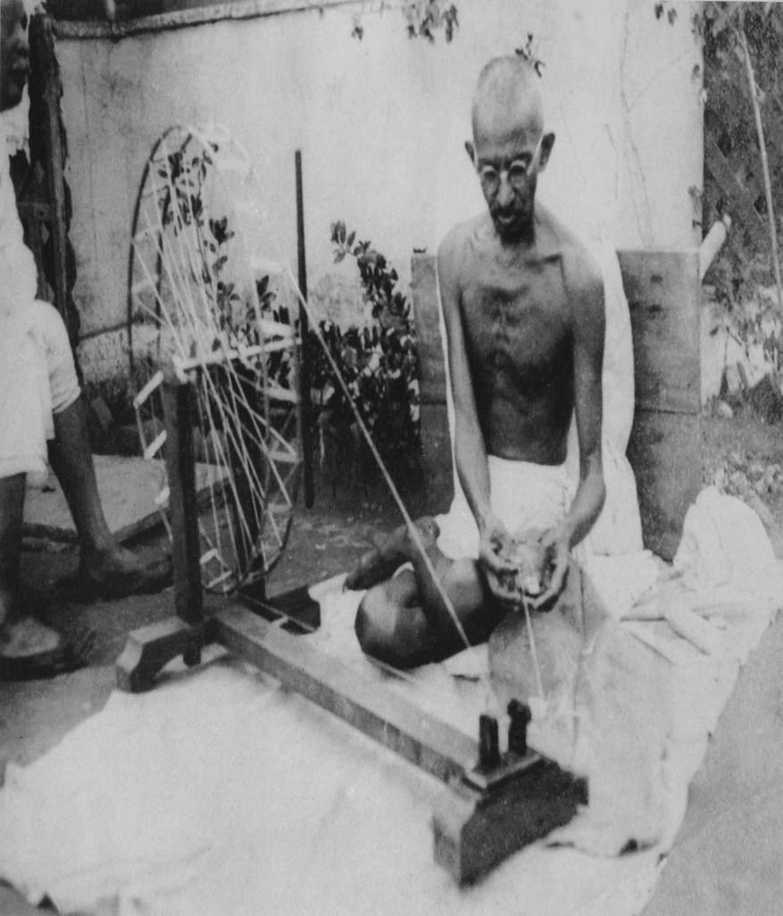
Mohandas Gandhi
Gandhi’s platform:
Sought the moral transformation of individuals
Worked to raise the status of India’s untouchables
Opposed a modern industrial framework for India
Wanted a society of harmonious and self-sufficient villages drawing on ancient Indian principles of duty and morality

Slide 11
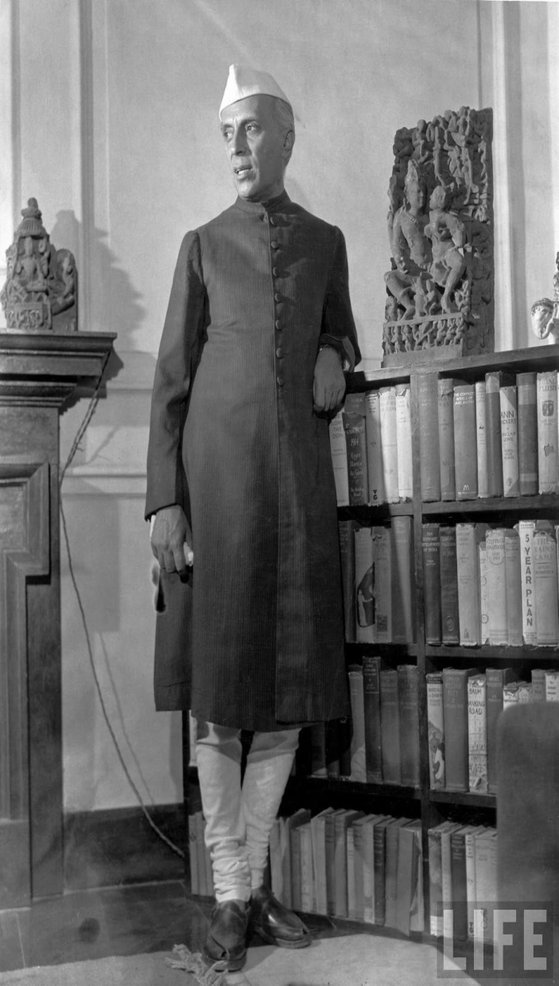
Divisions and Conflict within the INC
Many did believe science, technology, and industry were essential to India’s future
Like Gandhi’s chief lieutenant = Jawaharlal Nehru
Not everyone embraced nonviolence → existence of Hindu militant groups
Not everyone wanted an “inclusive” India → some Hindu groups expressed hatred of Muslims and wanted India to be a Hindu nation
Many believed focus on the position of women and untouchables distracted from the main goal of independence from Britain
Some favored participation in British-sponsored legislative bodies without complete independence

Slide 12
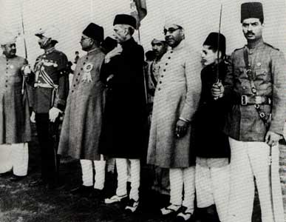
Divisions and Conflict within the INC
Most serious threat to a unified movement = divide between the Hindu and Muslim populations
1906 = formation of the All-India Muslim League
Feared domination by the Hindu majority
Muslim League argued that the parts of India that had a Muslim majority should have a separate political status
Wanted to call it Pakistan = “land of the pure”
Members of the All-India Muslim League

Slide 13
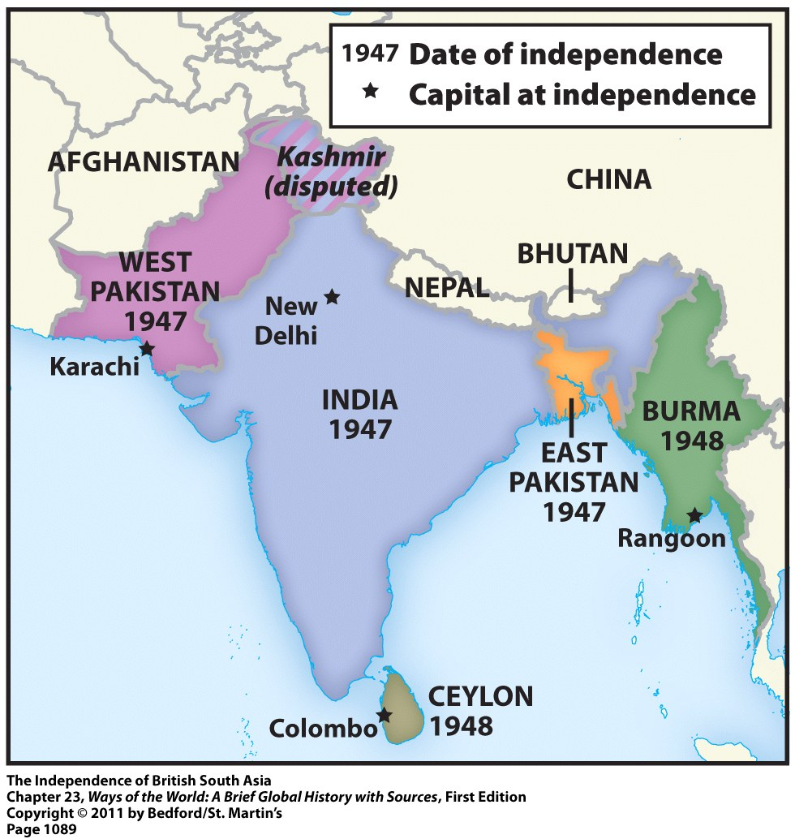
The Partition of India
Gandhi and the INC agreed to partition India when the British declared their intention to leave after WWII
1947 = colonial India became independent as two separate nations
Hindu India
Muslim Pakistan (divided into West and East Pakistan)

Slide 14
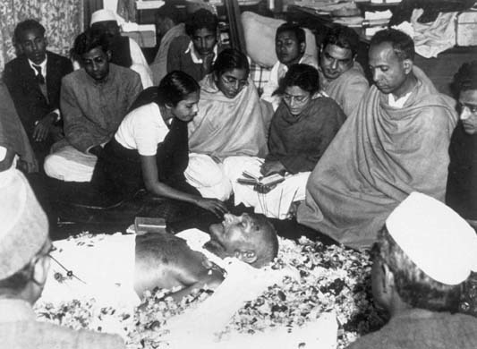
The Partition of India
Partition of India accompanied by severe violence:
1 million people or more died in the communal violence
About 12 million refugees moved from one country to another to be with their religious allies
1948 = Gandhi was assassinated by a Hindu extremist
Gandhi’s Funeral

Slide 15
Ending Apartheid in South Africa
Freedom struggle in South Africa = against an internal opponent, NOT an occupying colonial power
South Africa = independent since 1910
Independence granted to the white settler minority
Economically prominent = whites of British descent
Politically dominant = Boers or Afrikaners = white descendants of early Dutch settlers from the 1600s
Black African majority = had no political rights at all

Slide 16
Ending Apartheid in South Africa
Unlike India, South Africa had developed a mature industrial economy by the mid-1900s
Black Africans dependent upon this white-controlled economy → worked in urban industries, mines, or on white-owned farms
This dependence made them compliant with repressive actions of the colonial rulers
Only benefit = could threaten to collectively withdraw their labor
Johannesburg, South Africa (1952)

Slide 17
The African National Congress
African National Congress (ANC) = established in 1912
Association of educated, professional, and middle-class Africans
Original goal = to be accepted as “civilized men” within the existing order, NOT to overthrow it
Pursued peaceful and moderate protest for about 40 years = petitions, multiracial conferences, representatives appealing to the authorities
It became clear that these methods weren’t working

Slide 18
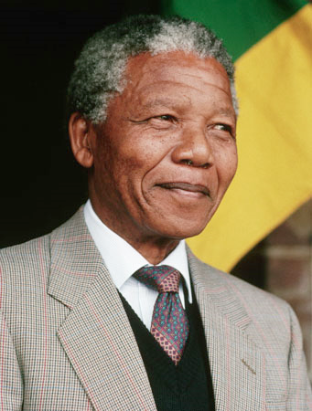
The African National Congress
1950s = ANC had new and younger leadership, which included Nelson Mandela
Broadened base of support
Nonviolent civil disobedience = boycotts, strikes, demonstrations, burning of black African passes

Slide 19
The African National Congress
Responses by the South African government:
Increased repression → including shooting at unarmed demonstrators
Banned the ANC
Imprisoned ANC leaders, including Nelson Mandela
Banned all other major political parties
Sharpeville, South Africa (1960)
For 2 days, police machine-gunned unarmed crowds protesting apartheid

Slide 20
The Freedom Struggle Intensifies
Underground nationalist leaders turned to armed struggle
Organized acts of sabotage and assassination; prepared for guerrilla warfare
Black Consciousness Movement = an effort to foster pride, unity, and political awareness among South Africa’s black African majority
Mostly made up of student groups
1976 = explosion of protest in Soweto (outside of Johannesburg)
Segregated and impoverished black neighborhood
Hundreds were killed

Slide 21
The Freedom Struggle Intensifies
Momentum from the protest in Soweto continued
Spreading urban violence and radicalization of urban young people
Mid-1980s = government declared a state of emergency
1986 (to commemorate 10th anniversary of Soweto uprising) = Congress of South African Trade Unions organized a mass strike involving about 2 million workers

Slide 22
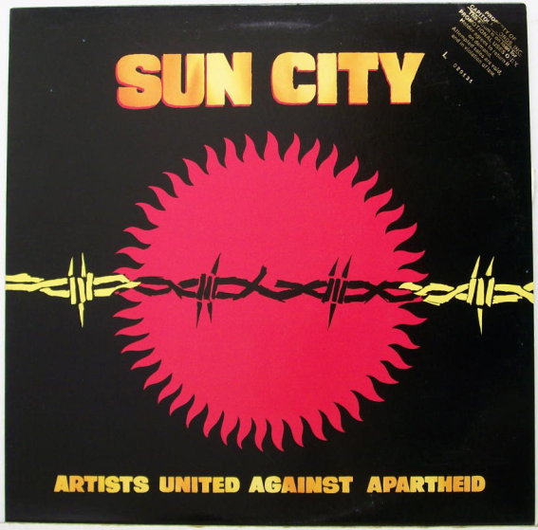
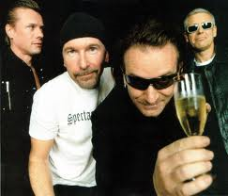
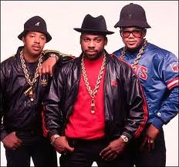
International Pressure to End Apartheid
South Africa was excluded from most international sporting events, including the Olympics
Artists and entertainers refused to perform in South Africa
Many countries enacted economic boycotts
Many countries withdrew their private investment funds
All of these factors isolated South Africa from the world

Slide 23
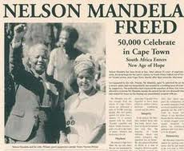
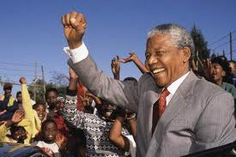
The End of Apartheid
Late 1980s = White South African leaders agreed to a process of negotiations with African nationalist leaders that led to:
The abandonment of apartheid policies
The release of Nelson Mandela from prison
The legalization of the ANC
National elections in 1994
Brought the ANC to power
Nelson Mandela = new president of South Africa

