Slide 1
Byzantine Empire

Slide 2
Fall of the Roman Empire
180 – End of Pax Romana
300 – Diocletian divides the Empire
313 – Constantine legalizes Christianity
410 – Visigoths sack Rome
455 – Vandals sack Rome
476 – Fall of the Western Roman Empire

Slide 3
East vs. West
Why was the fall of the western Roman Empire more severe than the eastern Roman Empire?
What were the consequences of the fall of the western half of Empire? Eastern half?

Slide 4
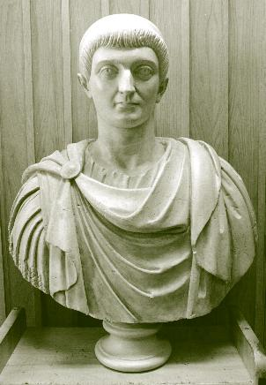
Eastern Rome: A Survivor Society
Constantine established the Eastern capital at Byzantium
Constantinople
Reasons for Survival
Higher level of civilization
Fewer nomadic invasions
Geography
Prosperous commerce
Stronger military

Slide 5
The Empire Continued
Continued to use many late Roman ideas
roads
taxation
military structure
court system
law codes
Christianity
Attempt to preserve Roman legacy
Called themselves Romans
Forbid German or “barbarian” customs
Could not wear boots, pants, or clothing made of animal skins
Could not have long hair

Slide 6
Justinian (527-565)
Byzantine empire reached greatest size under Justinian (527-565)
Wanted to rebuild Roman Empire
Temporarily regained North Africa, Italy and southern Spain
Wife, Theodora, had considerable power
Rebuilt Constantinople
Hagia Sophia
Justinian’s Code

Slide 7
Byzantine Empire under Justinian

Slide 8
Marriage
Role of
Parents
Assault and
Battery

Slide 9
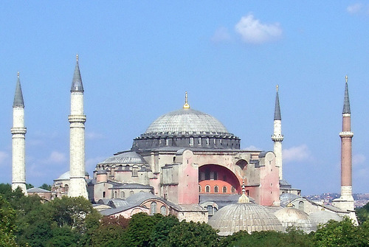
Hagia Sophia

Slide 11
The New Roman Empire
Never as large as the Roman Empire
Arab conquests in 7th century resulted in loss of Syria/Palestine, Egypt, & North Africa
Political authority centralized in Constantinople
Emperor claimed to be God’s representative on Earth
“Peer of the Apostles”
Borrowed Persian & Greek court rituals

Slide 12
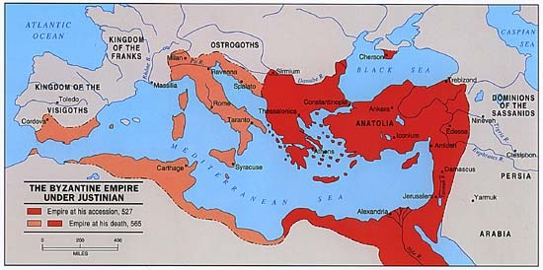
Decline of the Empire
Begins to decline in 1085
Expansion by rising European powers
The Crusades
The Fourth Crusade (1204)
Turkish Muslims – Seljuks
Decline slowed by “Greek fire”
Empire falls in 1453
Constantinople conquered by Ottoman Turks

Slide 13
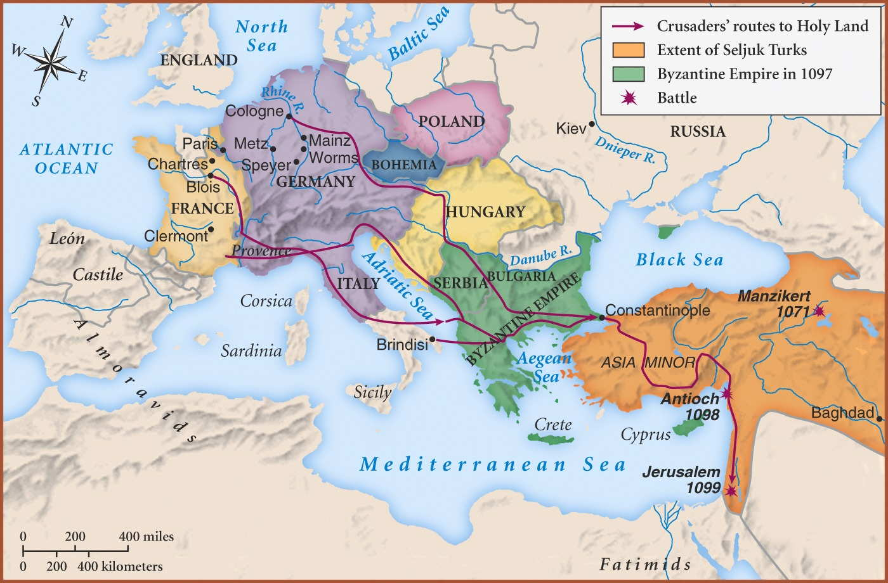
Byzantine Challenges

Slide 14
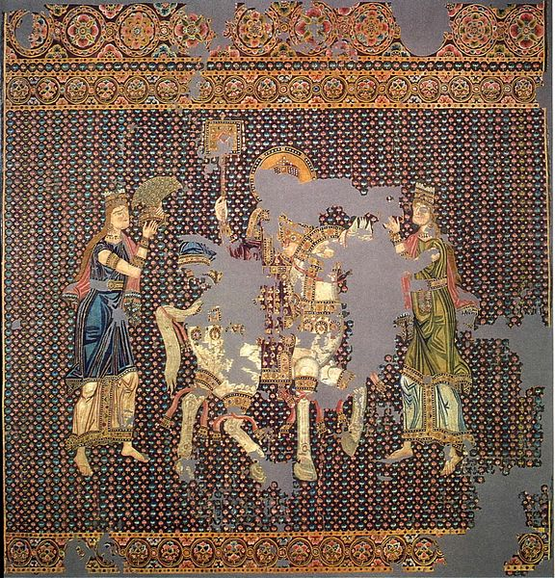
Byzantine Economy
Byzantine coins were the standard currency of Eastern Europe for 500 yrs
Manufacturing center
Glassware & mosaics
Thriving silk industry
Process spread from China
Government regulated production of silk
Established banks and business partnerships
Taxed merchandise that passed through empire
Notes:
No single person could weave, dye, or sell silk. Jobs divided to prevent the creation of a monopoly.

Slide 15
The “New Rome” - Constantinople
The “New Rome”
Political, economic, and cultural heart of the empire
Largest city in Europe
Nearly 1 million people
Important trade city
Western anchor of Eurasian trade routes
Silk Roads
Europe’s busiest marketplace

Slide 16
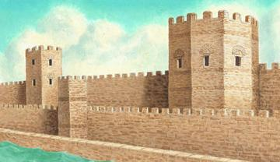
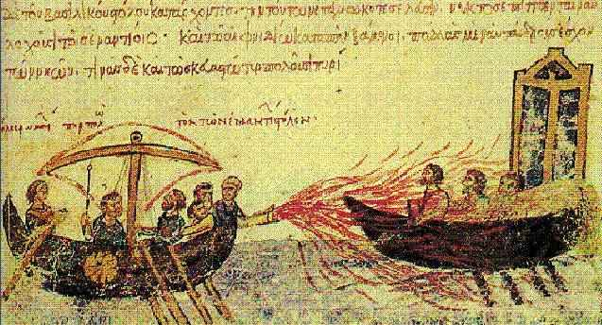
Constantinople in Byzantine Times

Slide 17
Byzantine Society
Early emperors prevented wealthy from seizing peasant’s land
Theme System
Army recruited soldiers from peasant class
Peasants received land for service
Free peasantry replaced by large estates in the 11th century
Led to declining tax revenue
Size of the army decreased
Frequent peasant revolts
Zealots of Thessalonica (1342-1350)

Slide 18
Byzantine Culture
Cultural Foundations
Christian beliefs
Greek learning
Roman engineering
Byzantine Education
State-organized schools
Widespread literacy
Chariot Races
Blues vs. Greens
Riot
City on the brink of collapse

Slide 19
The Great Schism - 1054
Orthodox Christianity
Roman Catholic Christianity
Eastern Europe
Constantinople
Greek
Iconoclasm
Priests could marry
Easter
Caesaropapism
Western Europe
Rome
Latin
Support use of icons
Priests must remain celibate
Christmas
Pope

Slide 21
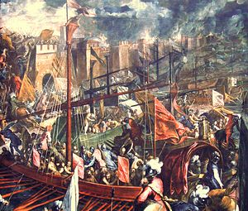
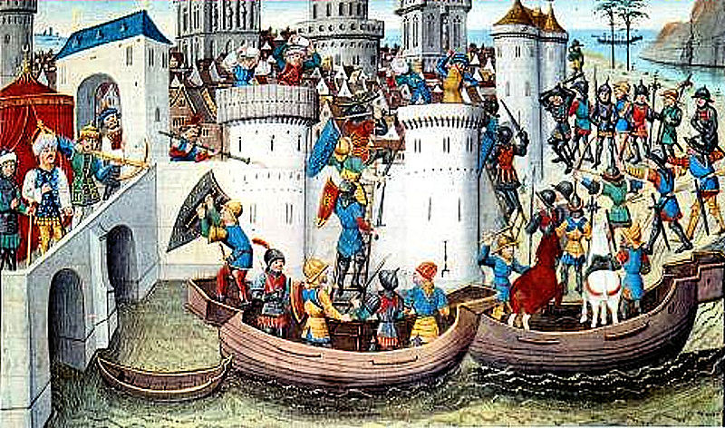
Effects of the Great Schism

Slide 22
Rise of Russia
Area inhabited by Slavs
Vikings arrive using river system
Set up state based on trade & conquest around 9th Century
State founded by Rurik
Capital at Kiev
People called Rus

Slide 23
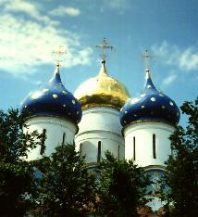
Russia & Christianity
Prince Vladimir converted in 989
Converted for trade, commercial reasons
Elites baptized by order of prince, often against will
Served as conduit for spread of Byzantine culture, religion
Cyrillic Alphabet
Famous Russian onion domes

Slide 24
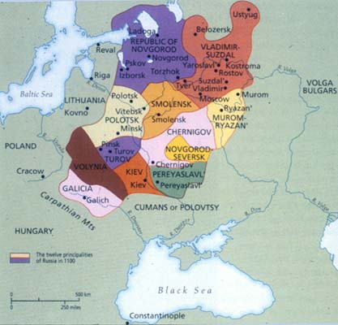
Kievan Rus
“Third Rome”
Decentralized government
Divided into provinces
Constant strife between boyars and princes
Constant threat of nomadic invasion

