Slide 1
City-States in Mesopotamia
Objectives:
Summarize how geography affected culture in the Fertile Crescent.
Describe city-states, and how other cultures learned about them.
Describe Sumerian religious beliefs, social structure, and technology.
Explain the influence of Sumer on later civilizations.

Slide 2
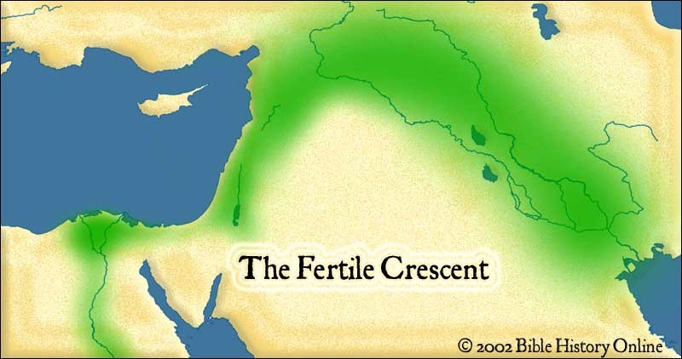
Geography of the Fertile Crescent
Fertile Crescent – Region lying between Tigris and Euphrates rivers in Southwest Asia
Region is also known as Mesopotamia “Land Between the Rivers”
Region known for yearly floods
Provided good soil for farming

Slide 3
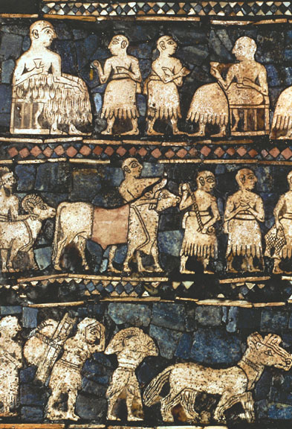
Sumerians Create City-States
By 3,000 B.C., Sumerians had built a number of cities that all shared the same culture
Developed different governments and laws
City-State – City and the surrounding land
Functioned as an independent entity
Sumer’s earliest governments were controlled by temple priests
In times of war, priests passed control over a city to a military general
In time, some military leaders became fulltime leaders
Passed on power to their heirs
Dynasty – Series of rulers from a single family
Standard of Ur from ancient Sumer ca. 2600 BCE.

Slide 4
Society
Social stratification
Slavery was common
One could become a slave through war, crime, or debt
Slaves were used in temples, public buildings, or private homes
Patriarchal
Women could hold most occupations

Slide 5
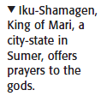
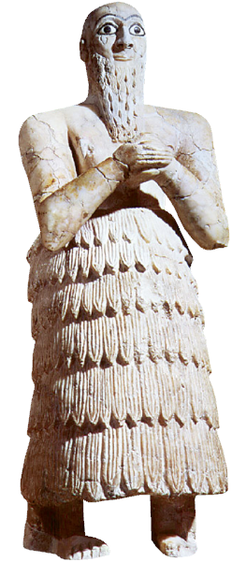
Sumerian Culture
Polytheism – Belief in multiple deities
Different gods controlled the various forces of nature
Sumerians gave their gods human qualities
Gods were wrathful
Offered sacrifices and built ziggurats
Life in Sumerian Society
With civilization came the beginning of social classes
Women had many rights
Sumerian Science and Technology
Arithmetic and geometry
Architecture
Cuneiform

Slide 6
Religion
Believed in 3,000 gods
Goal: Appease gods to control nature
Art and literature focus on gods and religion
Epic of Gilgamesh
Contains a story of an epic flood
Built ziggurats

Slide 8
Science, Technology, Communication
Inventions: wheel, sail, and plow
Bronze metallurgy
1st system of writing
Cuneiform
1st number system
Based on units of 10, 60, & 360
Astronomy

Slide 9
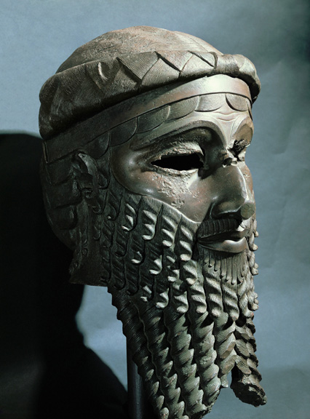
The First Empire Builders
Sargon of Akkad (2350 B.C.)
Took control of northern and southern Mesopotamia
Created the world’s first empire
Empire – Brings together different peoples or nations under one ruler
Babylonian Empire
Capital was located at Babylon on the Euphrates River
Empire reached its peak during the reign of Hammurabi
Mask of Sargon of Akkad.

Slide 10
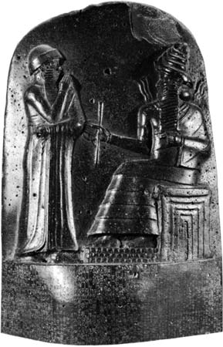
Hammurabi’s Code
First Unified System of Law
Hammurabi united different groups through the establishment of a unified code of law
Laws were engraved in stone and were placed all over the empire
282 specific laws
Was it Fair?
Hammurabi’s Code vs. US Laws
Have things changed much?
The upper part of the stele of Hammurabi's code of laws.
Notes:
Different punishments for different classes
Emphasis was on retaliation
“Eye for an eye”
Government was responsible for social ills

Slide 11
