Slide 1
Absolutism and the American Revolution

Slide 2
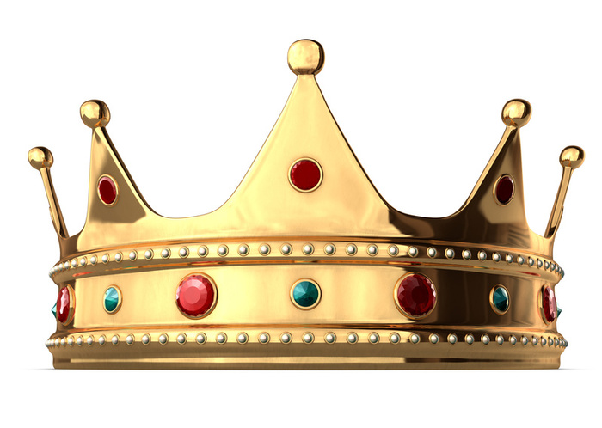
Absolutism
Absolutism = placed unlimited power in the monarch and his advisors
European monarchs wanted complete control and total loyalty of their subjects
Ruled by divine right = idea that monarchs receive their power directly from God and are responsible to God alone for their actions

Slide 3
Some of the most famous absolute monarchs…

Slide 4
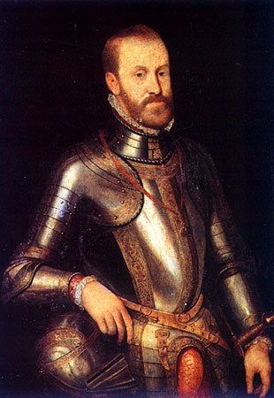
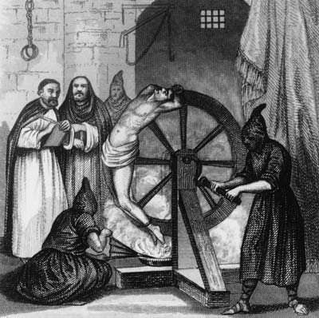
Spain → Philip II
Most powerful monarch in Spanish history
Strong Catholic -- wanted to end Protestantism in Spain
Supported the Inquisition & persecution of Jews and Muslims in Spain
Wanted to expand his control in Europe --> often led to costly wars

Slide 5
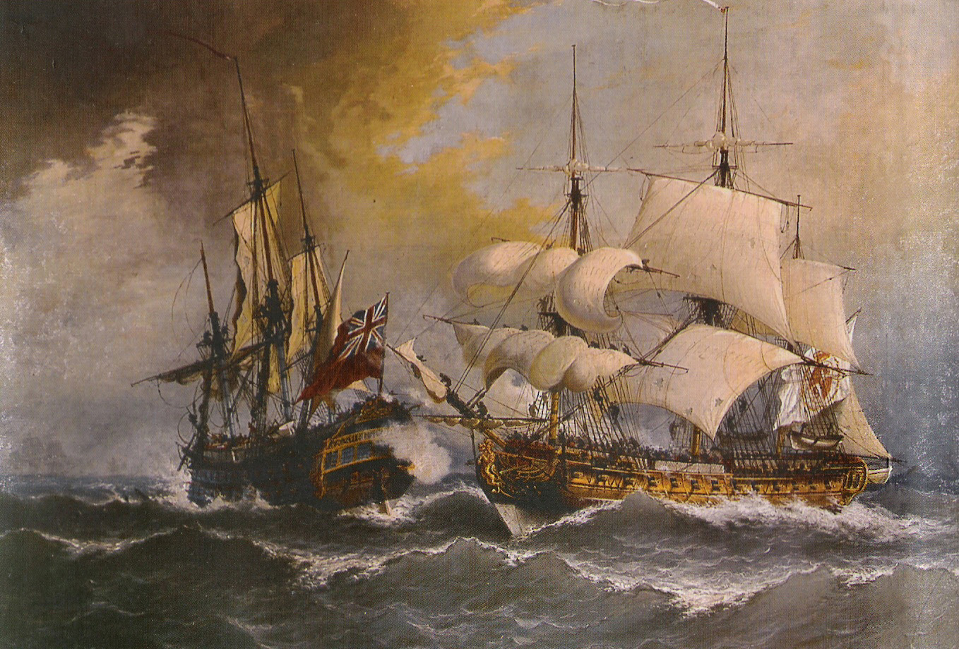
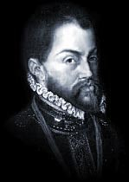
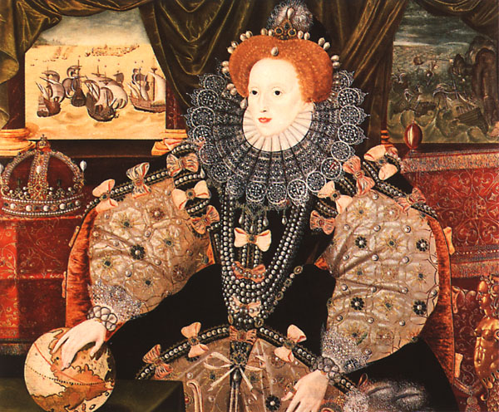
Spain → Philip II
1588 = Spanish Armada -- Philip II organized a fleet of ships to invade England
He clashed with the Protestant ruler of England = Queen Elizabeth I
England won
Started the decline of Spain
Hurt power of Philip II

Slide 6
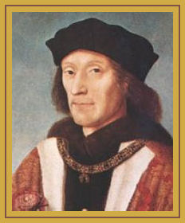
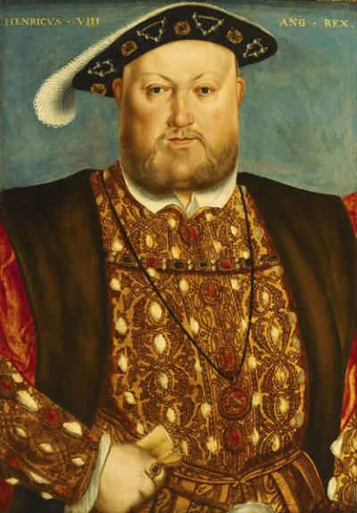
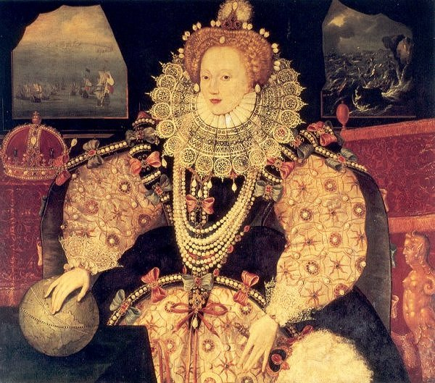
England → The Tudors
Henry VII = the first Tudor monarch
Henry VIII = most powerful of all Tudor monarchs
Queen Elizabeth I = created the Anglican Church

Slide 7
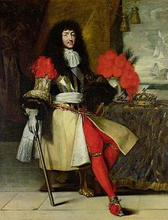
France → Louis XIV
Most powerful French monarch
Became King at the age of 5
Ruled for 72 years
Motto = “I am the state”
Nickname = the “Sun King” -- because everything revolves around him

Slide 8
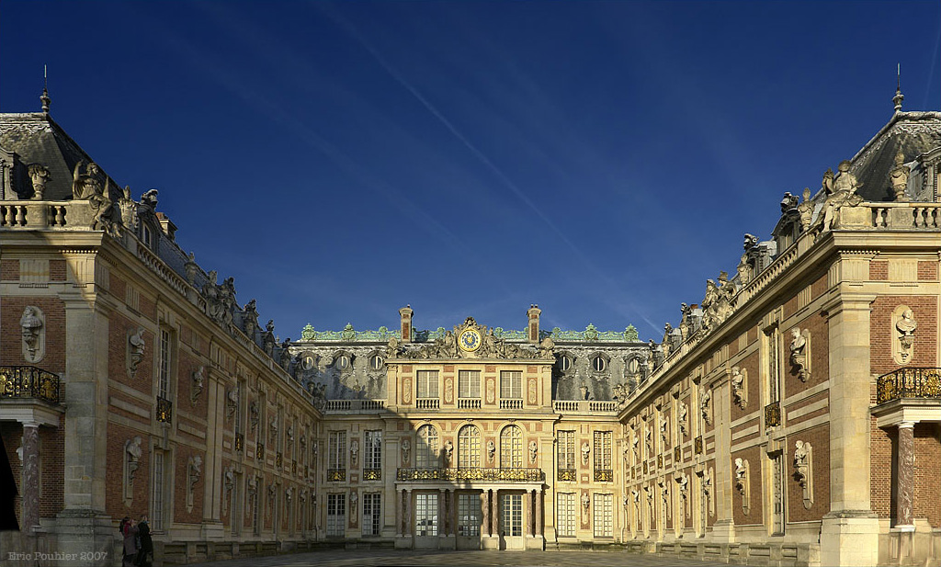
France → Louis XIV
Built the extravagant Palace of Versailles

Slide 9
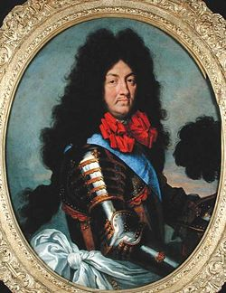
France → Louis XIV
Unjust tax system --> poor paid most of the taxes
Nobles, clergy, and government officials didn’t have to pay taxes
Eventually leads to the French Revolution
Religious policy = he saw Huguenots (French Protestants) as a threat
Wanted them to be Catholic
Revoked Edict of Nantes --> they could no longer practice their religion and their kids had to become Catholics
200,000 Huguenots left France

Slide 10
Russia → Peter the Great (Peter I)
Came to the throne in 1689
Wanted to bring Russia into contact with the rest of Europe
Forced the nobility to adopt western ways
Sent Russians to study in Europe
Brought the Eastern Orthodox Church under his control
Brought agriculture & factories under government control

Slide 11
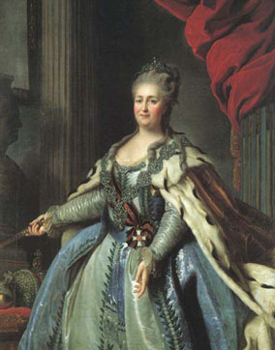
Russia → Catherine the Great (1762 - 1796)
Greatly influenced by European thinkers
Expanded Russia’s borders to the south & west
Peasants in Russia lived very poorly and were crushed whenever they started an uprising

Slide 12
The North American Revolution (1775-1787)

Slide 13
Comparing Atlantic Revolutions
Ideas Under Attack
Shared Ideals
Divine right of kings
State control of trade
Aristocratic privilege
Authority of a single church
Liberty
Equality
Free trade
Religious tolerance
Human rationality
Democracy
Popular sovereignty

Slide 14
North American Revolution
Struggle for independence from oppressive British rule
An effort to preserve the existing liberties of the colonies rather than create new ones
Up to this point → British colonists had enjoyed local autonomy and little interference from Britain
The British government was:
Tied up in internal conflicts
Tied up in European wars (especially with France)
More concerned with its Caribbean colonies because those were more profitable

Slide 15
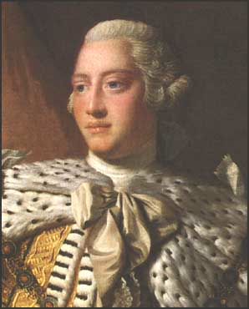
North American Revolution
What changed? → British government started to tighten its control over the colonies and to extract more revenue from them
Why? → British treasury was drained and national debt was through the roof due to its global struggles with France – Britain needed money!!!
What did they do? → Imposed a variety of new taxes and tariffs on the colonists without their consent
Colonists couldn’t do anything because they had no representatives in the British Parliament
King George III
“Tyrant” King of England

Slide 16
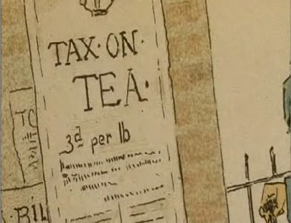
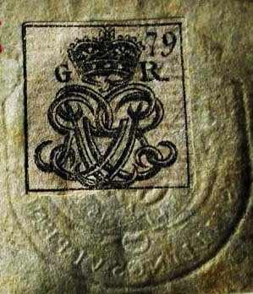
New Colonial Taxes (Just a few examples…)
Stamp Act (1765)
Placed a direct tax on all printed materials
Sugar Act (1764)
Placed a tax on sugar and molasses
Tea Act (1773)
Placed a 3-cents-per-pound tax on tea

Slide 17
Colonial Unrest After many unsuccessful attempts at peaceful resolutions with the British Parliament, the colonists started to get restless…

Slide 18
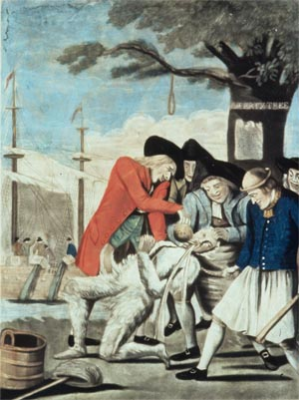
Tar and Feathering of Tax Collectors
“No taxation without representation!”

Slide 19
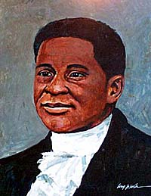
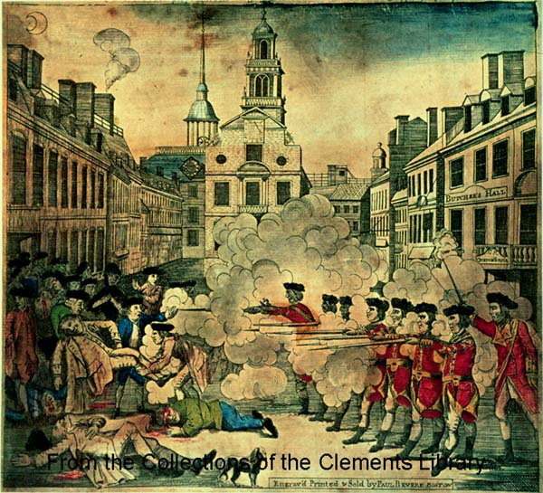
Boston Massacre (1770)
5 colonists killed by British soldiers
1st death = Crispus Attacks

Slide 20
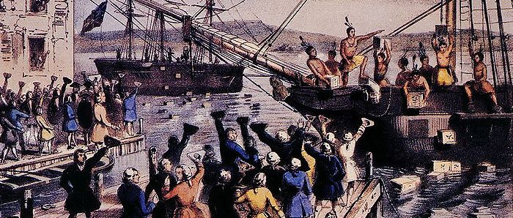
Boston Tea Party (1772)
Colonists dressed up as Native Americans
Dumped crates of tea and other goods into Boston Harbor

Slide 21
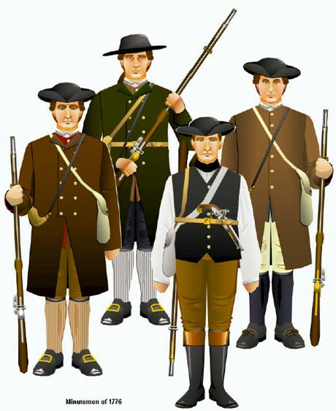
Creation of Volunteer Armies
Created in each colony
“Minutemen” → ready at a minute’s notice

Slide 22
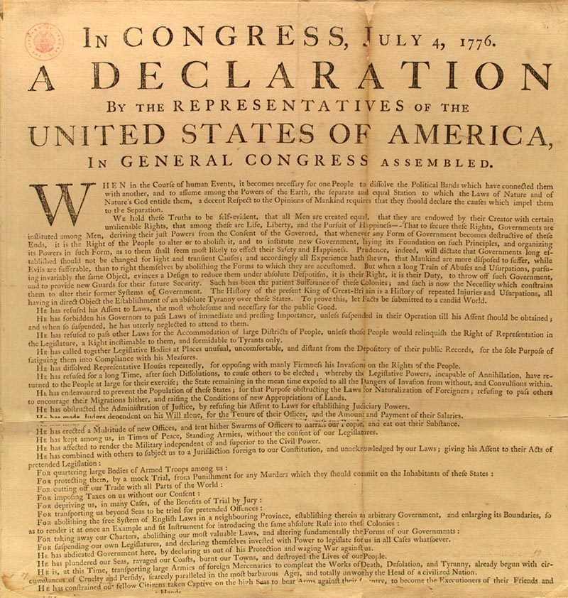
Declaration of Independence (1776)
Inalienable rights = life, liberty, and pursuit of happiness; can’t be taken away
Government created by a contract between the people and the government
If the government fails, people can overthrow it
Listed the colonists’ grievances with King George III

Slide 23
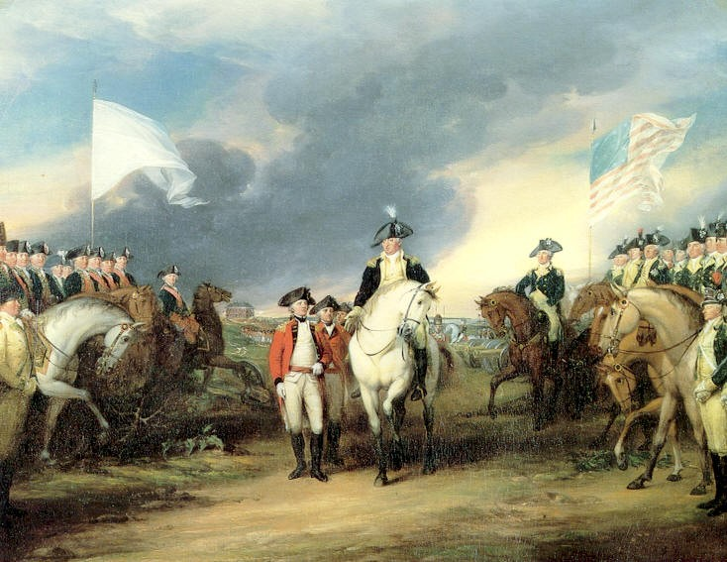
War for Independence
With this declaration, there was no turning back → the war for independence was officially on
Leader of colonial army = George Washington
1781 = Britain surrendered to the Americans in Yorktown, Virginia
With considerable aid from the French, the colonists were victorious
George Washington at the British Surrender at Yorktown

Slide 24
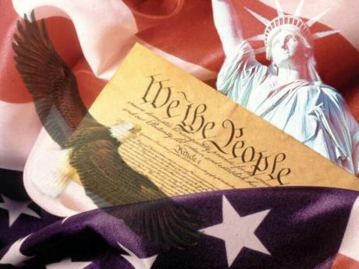
U.S. Constitution
Put the political ideals of the Enlightenment into practice
Federal system = power shared between national and state governments
3 Branches = executive, legislative, and judicial
System of check and balances

Slide 25
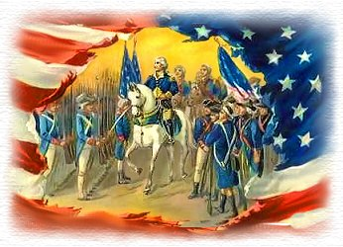
Results of the Revolution
Not accompanied by any huge social transformation
Accelerated the established democratic tendencies
Political authority = still in the hands of elites who had led the revolution
Property requirements for voting = lowered

Slide 26
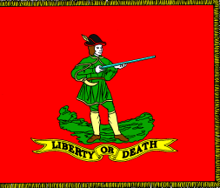
Results of the Revolution
Initiated the political breakdown of Europe’s “New World” empires
Inspired future revolutions and revolutionary leaders

