Slide 1
The Rise of Japan in the 19th Century (1800 – 1914)

Slide 2
Japanese Feudalism

Slide 3
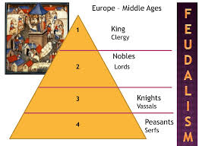

Slide 5
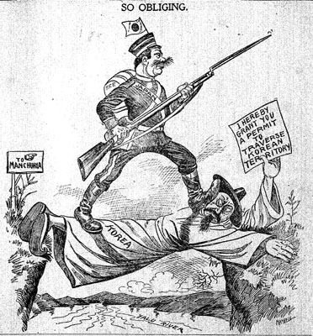
Japan’s Experience with Europe
Very different than China and the Ottoman Empire
Did not succumb to Western domination
Was able to turn itself into a powerful, modern, united, industrialized nation
Joined the “imperialism bandwagon” and created its own East Asian empire

Slide 6
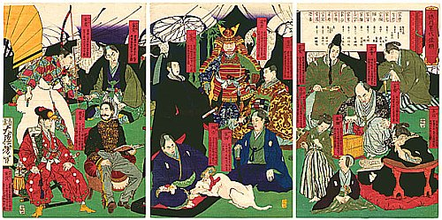
The Tokugawa Background
1600 – 1850 = Japan unified and ruled by the Tokugawa Shogunate
Shogun = military ruler
Emperor at this time = basically powerless
Chief task = prevent return of civil war among the 260 daimyo
Feudal lords → each with their own band of samurai
Shoguns brought peace to Japan for more than 2 centuries
Lineage of the Tokugawa Shoguns

Slide 7
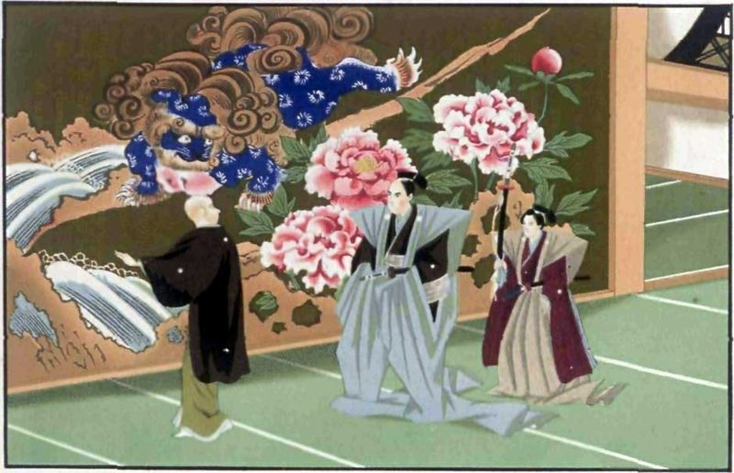
The Tokugawa Background
System devised to keep the daimyo in check = “attendance-in-turn”
Daimyo required to build second homes in Edo (the capital) and live there every other year
When they left for their rural residences, their families had to stay behind as hostages
Daimyo still enjoyed independence in their own domains → own law codes, militaries, tax systems, currencies, etc.
Japan was peaceful…but not truly unified
“A Daimyo Paying a State Visit”

Slide 8
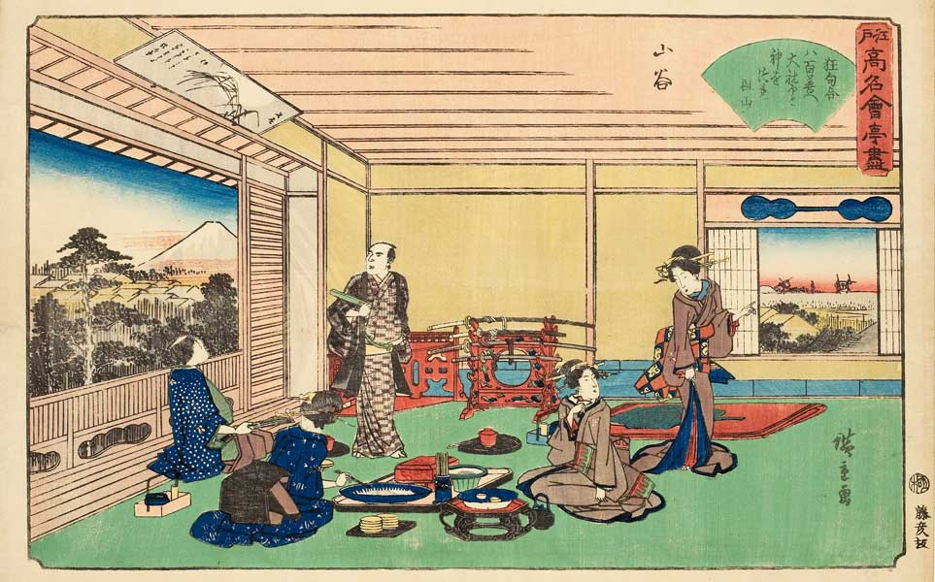
Economic and Urban Changes
Centuries of peace allowed for economic growth, commercialization, and urban development
By 1750 = most people in Japan lived in large towns or cities
Emerging capitalism → markets linked urban and rural areas
Encouragement of education = produced a very literate population
Japanese Teahouse during the Edo Period

Slide 9
Economic and Urban Changes
Merchants = thrived in this commercial economy
Had wealth, but no status → still considered the lowest in society according to the Confucian hierarchy
Many daimyo and samurai = found it necessary to borrow money from these “social inferiors”
Had high status, but no wealth
Japanese Merchants

Slide 10
Economic and Urban Changes
Peasants supposed to: devote themselves to farming, live simply, and avoid luxuries
Many peasants ignored this “law” and moved to the cities to become artisans or merchants
Ignored their “status” and imitated their superiors → example: used umbrellas instead of straw hats in the rain
Japanese Peasants

Slide 11
The Tokugawa Shogunate: Losing Control
In addition to these economic and social changes, other factors contributed to Shogunate’s loss of control in the early 1800s:
Corrupt and harsh officials
Severe famine in the 1830s that the shogunate could not deal with effectively
Expressions of frustration from the poor → peasant uprisings and urban riots
Japanese Peasant Infantry

Slide 12
American Intrusion of Japan
Since the early 1600s = Japan had deliberately limited its contact with the West
Expulsion of European missionaries
Harsh suppression of Christianity
Japanese forbidden from leaving
Only 1 port where the Dutch were allowed to trade
Early 1800s = European countries and the U.S. were “knocking on Japan’s door” to persuade them to reopen contact with the West
All were turned away
Even shipwrecked sailors were jailed or executed
Nagasaki Bay
Dutch Port during Japanese Isolationism

Slide 13
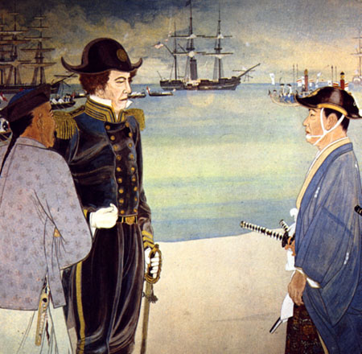
American Intrusion of Japan
1853 = U.S. Commodore Matthew Perry “opened” Japan
Commodore Perry demanded:
Humane treatment of castaways
Right of American ships to refuel and buy supplies
Opening of Japanese ports for trade
He was authorized to use force if necessary, but Commodore Perry approached the Japanese with gifts and a white flag
War was avoided
Commodore Perry Lands in Japan

Slide 14
American Intrusion of Japan
Japan agreed to a series of unequal treaties with the U.S. and different Western powers
They knew what happened to China when it resisted European demands – did not want that outcome
Results of this decision:
Loss of support for the ruling shogunate
Brief civil war
1868 = political takeover by a group of samurai from southern Japan → called the Meiji Restoration
“Eejanaika”
Dancing on the Eve of the Meiji Restoration

Slide 15
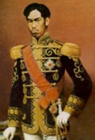
The Meiji Restoration
Goals of the Meiji Restoration:
Save Japan from foreign domination
Transform and modernize Japanese society by drawing upon Western achievements and ideas
This transformation becomes possible due to:
No massive violence or destruction in Japan as in China (Taiping Rebellion)
Less pressure from Western powers than in China and the Ottoman Empire
Japan = less sought after by Europeans because its location wasn’t very strategic and it didn’t have as many people or riches
U.S. ambitions in the Pacific = deflected by the Civil War and its aftermath
Emperor Meiji
(1867-1912)

Slide 16
Modernization Japanese Style
First task = true national unity = required an attack on the power and privileges of the daimyo and samurai
Ended the semi-independent domains of the daimyo
Replaced with governors appointed by and responsible to the national government
National government (not local authorities) now: collected taxes and raised a national army
Japanese Color Woodblock Print of Meiji Dignitaries (1877)

Slide 17
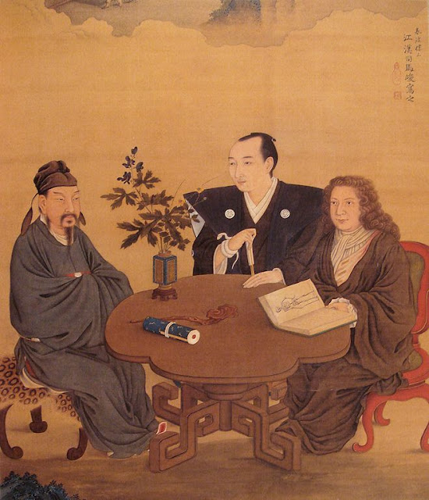
Modernization Japanese Style
Development of a nation-wide economy
Dismantling of old Confucian-based social order with its special privileges for certain classes
All Japanese became legally equal
Official missions to Europe and the U.S. to learn about the West
A Meeting of Japan, China, and the West

Slide 18
Modernization Japanese Style
Japan borrowed many ideas from the West and combined these foreign elements with Japanese elements
Goal = modernize and maintain unique culture
Ex: Modern education system included Confucian principles

Slide 19
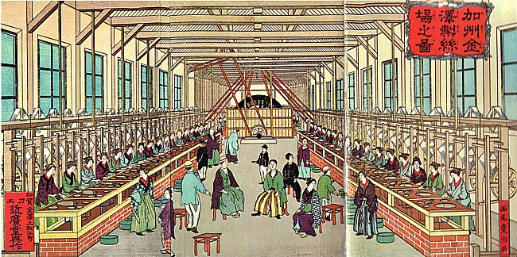
Japan’s State-Guided Industrialization Program
Government set up a number of enterprises and later sold them to private investors
Used own resources when industrializing
Became a major exporter of textiles and was able to produce its own manufactured goods
Painting of a Western-Style Japanese Factory from the 1880s

Slide 20
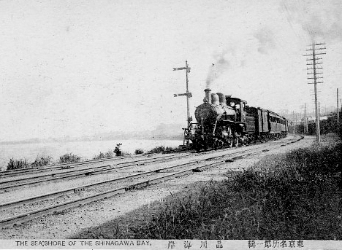
Japan’s State-Guided Industrialization Program
The Japanese government also:
Built railroads
Created a postal system
Established a national currency
Set up a national banking system
Japanese Steam Train (1872)

Slide 21
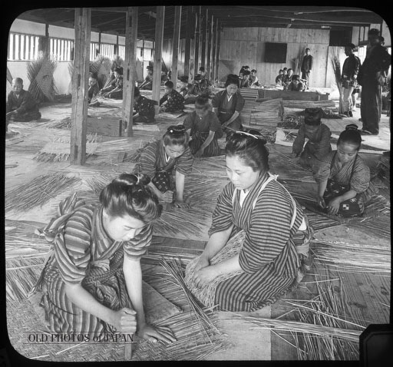
Social Results of Industrialization
Many peasant families slid into poverty → taxed too much to pay for Japan’s modernization
Protests with attacks on government offices and bankers’ homes
Low pay and terrible working conditions for factory workers (mainly women)
Female Workers in a Japanese Bamboo Basket Factory (1904)

Slide 22
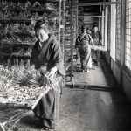
Social Results of Industrialization
Anarchist and socialist ideas developed among intellectuals
Efforts to create unions and organize strikes → met with harsh opposition

Slide 23
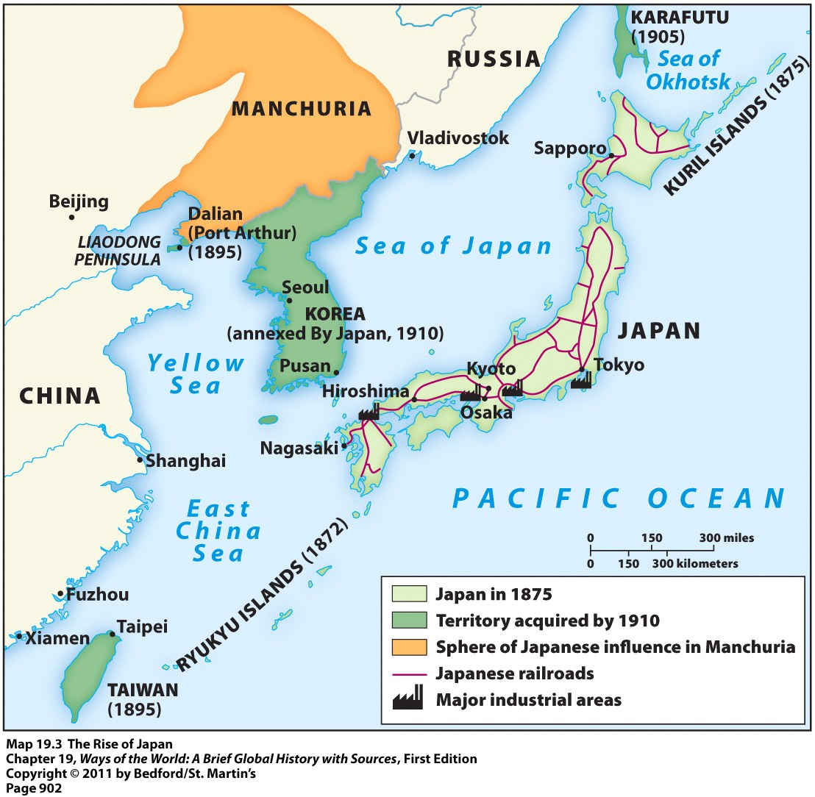
Japanese Imperialism
Japan led successful wars against:
China (1894-1895) → gained colonial control of Taiwan and Korea
Russia (1904-1905) → gained a territorial foothold in Manchuria
Japan = first Asian state to defeat a major European power

