Slide 1
European Imperialism
AP World History

Slide 2
Mounting Problems
During the 1800s = most of the peoples of Asia, the Middle East, Africa, and Latin America were facing:
Internal problems and crises
A powerful and expanding Europe
Some countries maintained their formal independence from Europe
China, the Ottoman Empire, Japan
Some countries fell under official control of European powers
Many countries in Africa and Asia

Slide 3
Facing Europe
Four dimensions of an expansive Europe confronted these societies:
Immense military might and political ambitions of rival European states
Networks of trade, investment, and migration that stemmed from industrial and capitalist Europe
Aspects of traditional European culture → languages, Christianity, European literature and philosophy, etc.
Culture of modernity → scientific and technological achievements; ideas of nationalism, socialism, feminism, and individualism

Slide 4
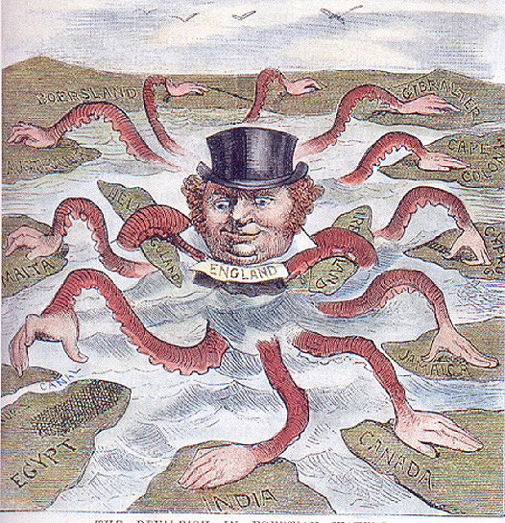
European Imperialism: General Information
Imperialism = empire building = extending the rule of an empire over foreign territories and acquiring colonies
Took place between: 1812 and 1914
Territories officially incorporated into European colonial empires = India, Africa, Southeast Asia, and the islands of the Pacific
A colony = a territory separate from, but ruled by, another power
A sphere of influence = a region of the world in which one state is dominant
Depiction of British Imperialism

Slide 5
European Imperialism: Motives
Main catalyst = the Industrial Revolution
Motive #1: New economic needs → raw materials, agricultural products, etc.
Needed to look abroad to find these
Motive #2: Needed markets to sell their finished products to
More products sold = more money
Kept factories running and workers employed

Slide 6
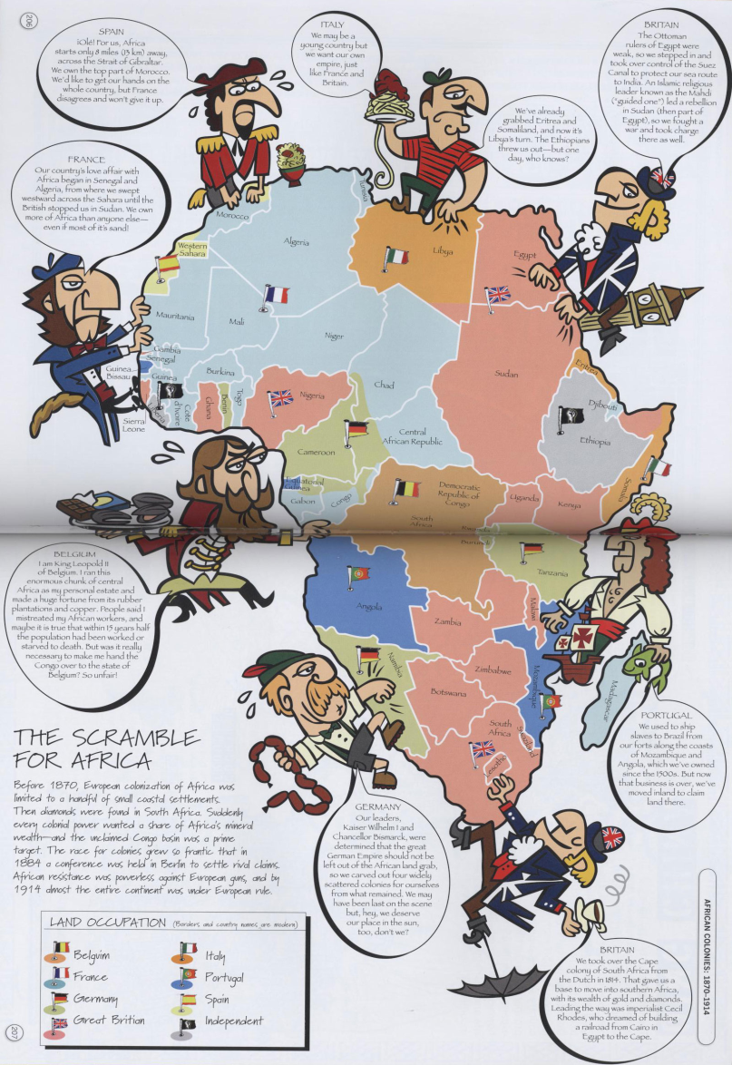
European Imperialism: Motives
Another factor driving European imperialism = rising nationalism
Nationalism = loyalty to one’s own nation and the desire for national independence and advancement
Intensified rivalries between European states
Colonies and spheres of influence became symbols of national “Great Power” status
Result = nations tried to acquire as many territories as quickly as possible → even if they had no real economic value

Slide 7
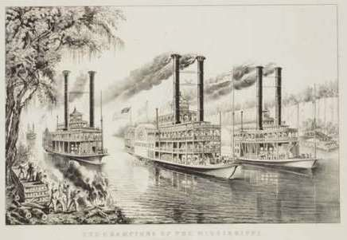
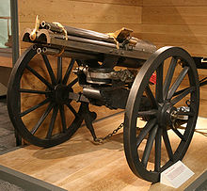
European Imperialism: Industrial Technologies
Many advancements produced during the industrial era aided Europeans in their imperial quests:
Steam-powered ships = could now reach distant African and Asia ports quickly; could navigate along interior rivers
Underwater telegraph = made possible instant communication with far-away outposts of the empire
Discovery of quinine = prevented malaria
Breech-loading rifles and machine guns = widened the military gap between Europe and everyone else
The Gatling Gun = One of the earliest machine guns
Notes:
Quinine = found naturally in the bark of cinchona trees; used as the first effective treatment for malaria
Used until the 1940s

Slide 8
European Perceptions of the “Other”
In the past = Europeans believed in their “religious superiority” over others
With industrialization, they developed a more secularized view of their own superiority
They had started the Scientific and Industrial Revolutions, amassed great wealth, and built up a supreme military
New “racial superiority” developed = based on modern “science”

Slide 9
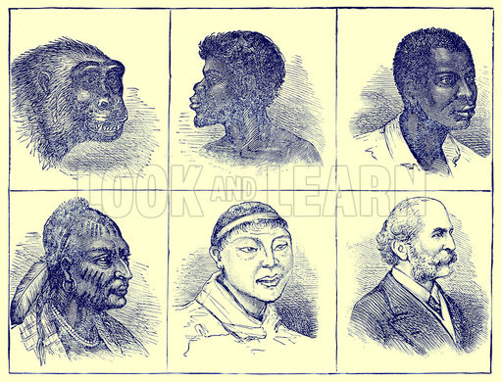
Science-Based “Racial Superiority”
Scientists and physicians measured and classified the size and shape of human skulls
Conclusion = skulls of white people = larger = therefore more advanced
Biologists applied notions of “rank” to human beings
Result = a hierarchy of races
Whites on top and less developed races beneath them
New theory = race determined human intelligence, moral development, and destiny
Conclusion = European expansion was natural and inevitable
“The Progressive
Development of Man”

Slide 10
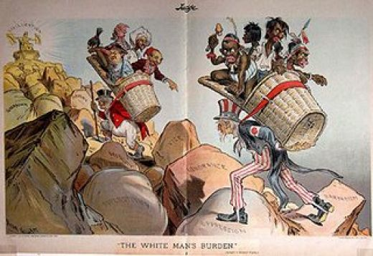
“The White Man’s Burden”
Europeans felt a sense of responsibility to the “weaker races”
Author Rudyard Kipling referred to this idea as the “white man’s burden”
Belief in a “civilizing mission” = meant bringing:
Christianity to the heathen
Good government to the disordered lands
Work discipline and production for the market to “lazy natives”
Education to the uneducated and illiterate
Clothing to the naked
Health care to the sick

Slide 11
Social Darwinism
“Survival of the fittest” – but in society
Natural weeding out of “weaker” peoples of the world would allow the “stronger” to flourish
Belief = European dominance involved the displacement or destruction of backward peoples or “unfit” races

Slide 12
China
Internal Troubles, External Threats
1800-1914

Slide 13
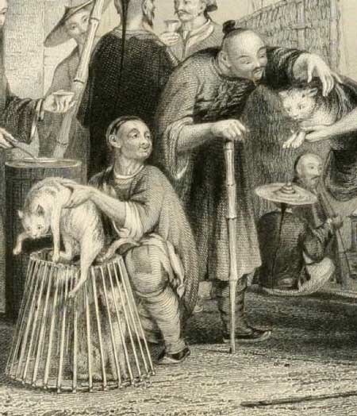
China: The Crisis Within
1700s to mid-1800s = massive population growth
Results:
Growing pressure on the land
Smaller farms for China’s huge peasant population
Unemployment
Poverty
Starvation and misery
Poor Chinese Cat Merchants, 1843
(Sold for food, not as pets!)

Slide 14
China: The Crisis Within
China’s centralized government did not expand to cope with this growing population
Became unable to effectively perform many functions
Tax collection
Social welfare
Flood control
Public security
Result = central government lost power to officials in the provinces and local landowners
Many were corrupt
Treated the peasants very harshly

Slide 15
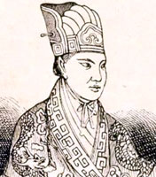
The Taiping Rebellion
Led to many peasant rebellions and uprisings
1850 – 1864 = Taiping Rebellion
Leaders believed in a unique form of Christianity
Leading figure = Hong Xiuquan = proclaimed to be the younger brother of Jesus
Sent to establish a “heavenly kingdom of great peace” in the world
Painting of the Battle of Sanhe
A major engagement of the Taiping Rebellion
Notes:
“Taiping” = of Chinese origin; in that language, it refers to “peace”

Slide 16
Goals of the Taiping Rebellion
Abolition of private property
Radical redistribution of land
Equality of men and women
End of foot binding, prostitution, and opium smoking
Sexually segregated military camps of men and women
Expulsion of all Qing dynasty “foreigners”
Transformation of China into an industrial nation with railroads, health care for all, universal public education, etc.
Taiping Soldiers Outside Shanghai

Slide 17
The Taiping Rebellion: Eventual Failure
Taiping forces and followers swept out from southern China and established their capital in Nanjing in 1853
Uprising eventually failed due to:
Divisions and indecisiveness within Taiping leadership
Inability to link up with other rebel groups throughout China
Western military support for pro-Qing forces
Rebel forces finally crushed in 1864
Painting of the Taiping Rebellion

Slide 18
The Taiping Rebellion: Effects on China
Weakening of the Qing centralized government
Disruption and weakening of China’s economy
Destruction and devastation to the land
Estimated 20-30 million lives lost
Continued social instability
Chinese Peasants in the 19th Century

Slide 19
China: Western Pressures
Shifting balance of power between Europe and China evident in the Opium Wars
Late 1700s = British began to grow and process opium in India and illegally sell the highly addictive drug to the Chinese to make up for its trade imbalance with them
By 1830 = very profitable market for British, American, and other Western merchants
“Factories” where British and American merchants sold opium in Canton, China

Slide 20
Chinese/British Trade at Canton (1835-1836)
 | Item | Value (in Spanish dollars)
British Exports to Canton | Opium | 17,904,248
 | Cotton | 8,357,394
 | All other items (ex: iron, tin, etc.) | 6,164,981
 | Total | 32,426,623
British Imports from Canton | Tea | 13,412,243
 | Raw silk | 3,764,115
 | Vermilion | 705,000
 | All other goods (gold, copper, etc.) | 5,971,541
 | Total | 23,852,899
What kind of shape would the British have been in without opium???
Notes:
Vermilion comes from cinnabar, a common ore of mercury mined in China
Has an orange-red pigment; used in dyes

Slide 21
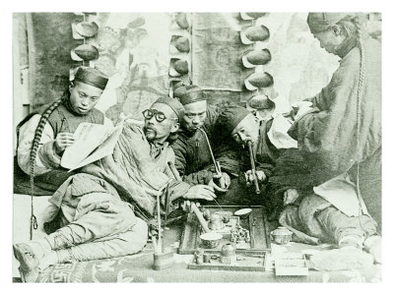
The Opium Trade
China had several problems with the opium trade:
Political problem = Opium was illegal → it disregarded Chinese law and led to the corruption of many Chinese officials who were bribed to turn a blind eye to the smuggling
Economic problem = Massive outflow of silver to pay for opium was causing serious economic decline
Social problem = Millions of men and women became addicted and couldn’t function as productive citizens
Chinese Opium Den

Slide 22
The Opium Trade
1836 = Chinese emperor decided to crack down on opium use
Millions of pounds of opium seized from traders and destroyed without compensation
Western merchants expelled from the country
British response = sent naval expedition to China
Offended by violation of property rights
Wanted to end the restrictive conditions under which they’d long traded with China
Result = 1st Opium War
Confiscated opium being burned

Slide 23
The First Opium War
The British = had superior military might and easily won
Treaty of Nanjing ended the war in 1842
Imposed restrictions on the power of the Chinese emperor
Opened 5 ports to European traders
The Outbreak of the First
Opium War

Slide 24
The Second Opium War (1856-1858)
British forces were victorious once again
Treaty of Tientsin ended the war in 1858
10 more ports opened to foreign traders
Foreigners allowed to travel freely and buy land in China
Foreigners allowed to preach Christianity under the protection of Chinese authorities
Foreigners allowed to navigate along and patrol some of China’s major rivers
Chinese forbidden from referring to the British as “barbarians” in official documents
Painting of the Second
Opium War

Slide 25
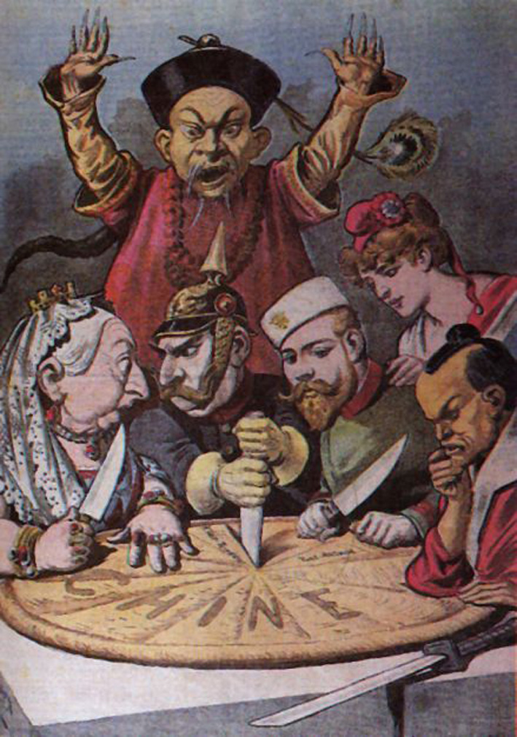
Further Chinese Military Defeats
1885 = lost to the French in the Sino-French War
Lost territory of Vietnam to the French
1895 = lost to Japan in the Sino-Japanese War
Lost territories of Korea and Taiwan to the Japanese
By the end of the 1800s = European powers, Russia, and Japan had all carved out spheres of influence in China
Established military bases
Extracted raw materials
Built railroads
Carving Up the Pie of China
French Political Cartoon, 1890s
Notes:
Left to right: Great Britain’s Queen Victoria, Germany’s Kaiser Wilhelm, Russia’s Tsar Nicholas II, a female figure representing France, and the Meiji emperor of Japan.
All are dividing up China; behind them is a Chinese figure trying helplessly to stop the partition of his country.

Slide 26
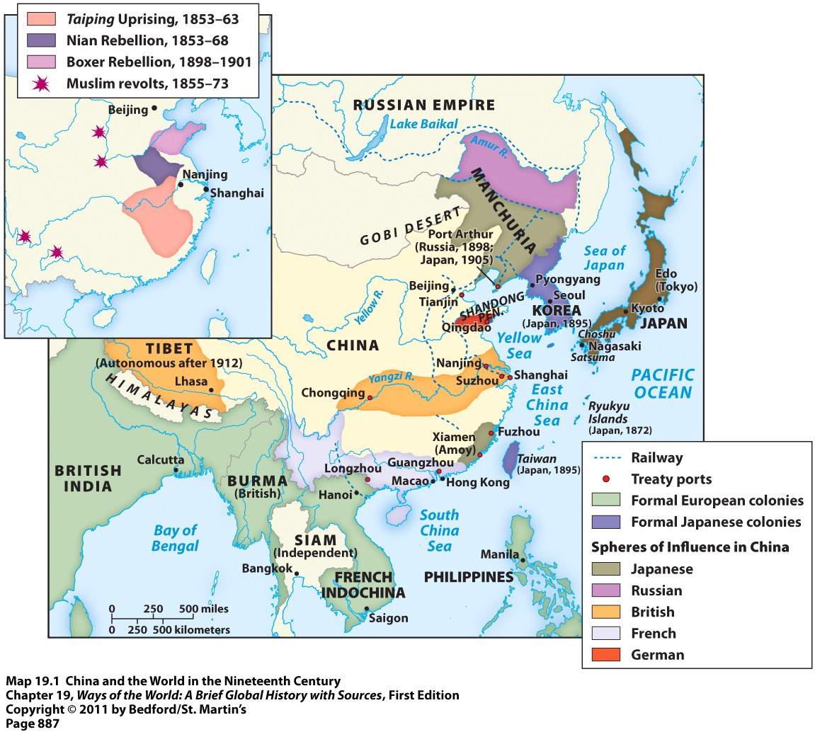
Spheres of Influence in China

Slide 27
China: Failed Attempts at Modernization
1860s-1870s = “self-strengthening” policies implemented to reinvigorate a traditional China
Overhauled examination system = designed to recruit qualified candidates for official positions
Support for landlords
Repair of irrigation systems
A few industrial factories → producing textiles and steel
Coal mines expanded
Telegraph system initiated
Creation of modern arsenals, shipyards, and foreign language schools
Nanjing Jinling Arsenal

Slide 28
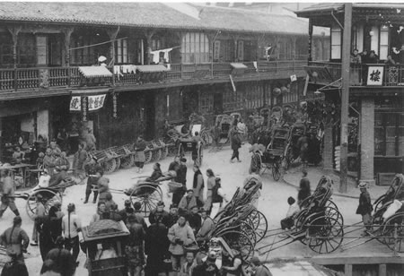
China: Failed Attempts at Modernization
Problems with China’s “self-strengthening” program that eventually led to its failure:
Little support from conservative leaders → feared urban, industrial, and commercial growth would hurt the power and privileges of the landlord class
New industries = largely dependent on foreigners for machinery, materials, and expertise
New industries only helped local authorities who controlled them, not the Chinese state
China during the time of the Self-Strengthening Movement

Slide 29
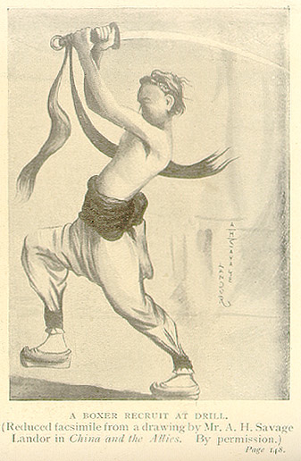
The Boxer Rebellion (1898 – 1901)
Clear indication of the failure of the “self-strengthening” program
Erupted in northern China
Anti-foreign movement
Led by militia organizations called the Society of Righteous and Harmonious Fists
“Boxers” killed many Europeans and Chinese Christians and attacked the foreign embassies in Beijing
A Boxer Recruit at Drill
Notes:
Society of Righteous and Harmonious Fists = secret society from northern China; made up mostly of people who had lost their livelihoods due to imperialism or natural disasters
Believed that through training, diet, martial arts, and prayer they could perform extraordinary feats
Foreigners called them “Boxers” because of the martial arts and calisthenics they did
“Spirit Possession” = involved the whirling of swords and chanting incantations to Daoist and Buddhist spirits

Slide 30
The Boxer Rebellion (1898 – 1901)
European and Japanese forces occupied Beijing to crush the rebellion
Imposed a huge payment on China as punishment
Clear that China was a dependent country under foreign control
Boxer Armies Fighting the Eight-Nation Alliance
(British and Japanese soldiers depicted)

Slide 31
Growth of Chinese Nationalism
Late 1890s = educated Chinese began organizing groups to examine China’s desperate situation and explore alternatives
Frustrated with the Qing dynasty → foreign and ineffective in protecting China
Admired Western science and technology
Admired Western political practices
Limited authority of the ruler and wider circles of political participation
Believed the only thing that could save China = a truly unified nation in which rulers and ruled were closely related
Chinese Political Cartoon
Goal = encourage people to stand up against Qing dynasty and “sweep” them out of China

Slide 32
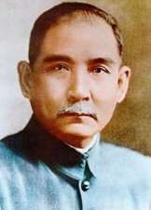
Growth of Chinese Nationalism
Result of these groups and their leaders = the birth of Chinese nationalism
Directed against both foreign imperialists and the foreign Qing dynasty
Qing dynasty could not effectively respond to new pressures by Chinese nationalists
1911 = ancient imperial order of China collapsed
Ended an order that had governed China for 2,000 years
Sun Yat-Sen
Chinese revolutionary
Leader in the overthrow of the Qing dynasty
First President of the new Republic of China (1912)

